Slide 1
You’ve spent years working on your skills as a software developer. You measure your days by the number of commits you’ve made and look forward to the daily pairing sessions with your team mates. Then, one day, a leadership position opens up on your team and you start thinking about it. Should I or shouldn’t I? What if I go for it and end up hating it or I’m just not that good at it? What if I love it? How will my day change? In this interactive session, we’ll explore “why leadership”, answer some hard questions and talk about one developer’s path from writing code to leading people and the challenges that have been experienced.

Slide 2
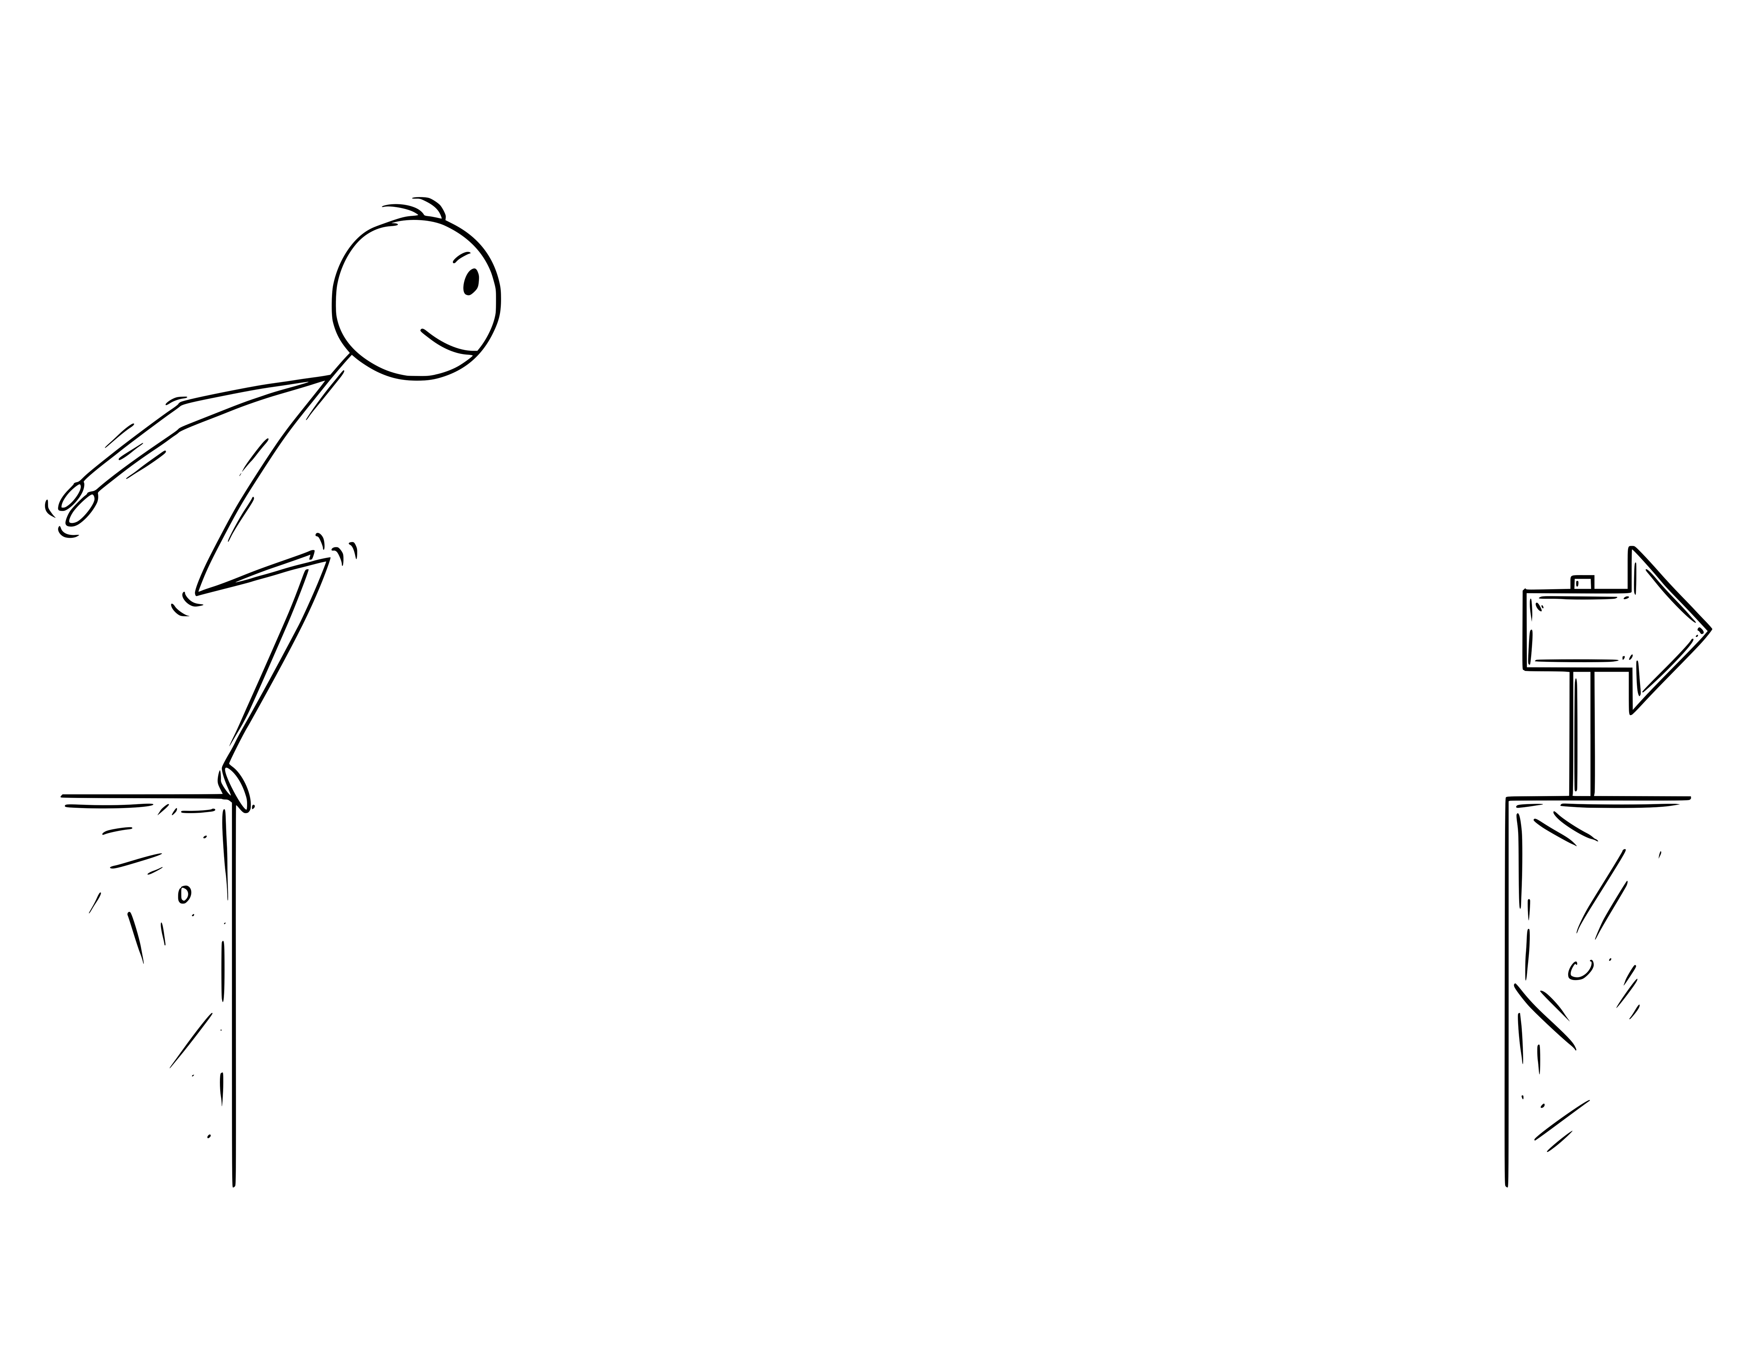
Dev to Leader
One Developer’s Story
CincyDeliver 2023

Slide 3

Father
Husband
Developer
Leader
Speaker
Writer
Notes:
First, a little about me.
I'm father to two teenagers - the oldest just turned 18 and the youngest turns
16 in July. I've been married for 22 years, and have actually known my wife
since kindergarten. I've been developing software since the early 90s - my
first professional gig was found on Compuserve. I'm a leader. I speak at
conferences, mostly on soft topics like leadership, remote working, emotional
intelligence. I also like to write, but not nearly enough and most of it never
makes it out for the public.

Slide 4
Quick Poll
Notes:
Ask how many are people leaders in the room
How many have been a people leader and gone back to being an IC?
How many see eventually making the move to being a people leader?

Slide 6
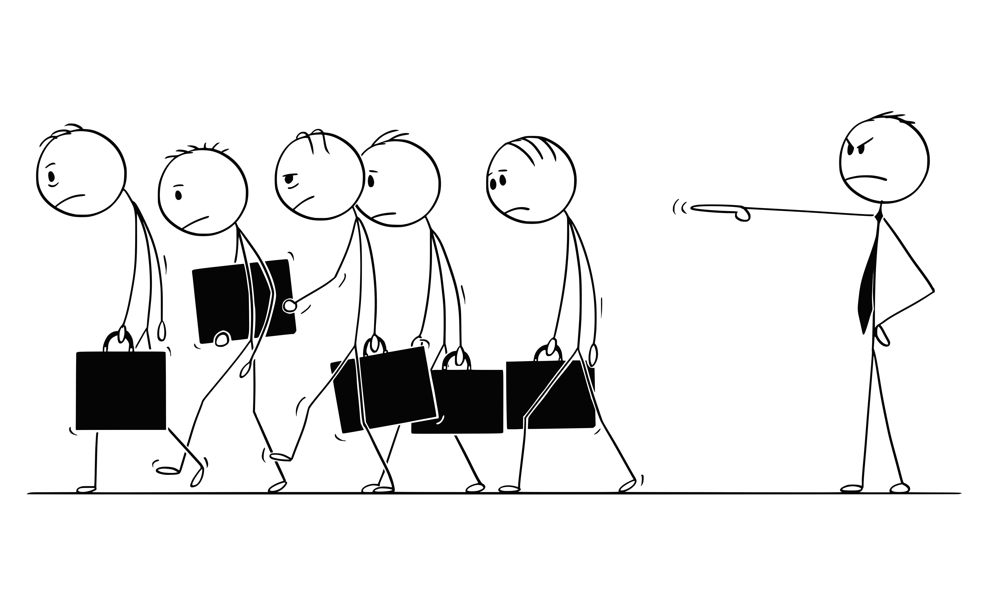
Notes:
Traditional leadership generally involves the accumulation and exercise of power by one at the “top of the pyramid.”
Leadership is NOT being a dictator.
It’s not about holding power over people. It’s not about building your kingdom so YOU get ahead.

Slide 7

Servant Leadership
Notes:
By comparison, the servant-leader shares power, puts the needs of others first and helps people develop and perform as highly as possible.
You do NOT need a title to be a servant leader.

Slide 8

First and foremost, as a leader your #1 job is to protect your people.
-Jim Holmes

Slide 9
Leadership !=
Notes:
I am a huge believer that leaders should be celebrating the successes of the team and taking full responsibility for any failures. Leadership is about protecting your team. It’s about helping them grow and removing obstacles. It’s not about building your kingdom.
Story about Igor… (I want to be a leader so I can tell people what to do and how to do it)

Slide 10
My Path
Notes:
Like I said, I started out in the early-to-mid 90's. Most of what I did involved Visual Basic - versions 2-6. I worked at some cool places, writing some cool software.
In 2000, I took on the role of Project Director for a consulting company. Basically, I was a glorified tech lead. I didn't have the ability to hire, fire or give people raises. I did have team members come to me with personal problems, and honestly, in my late 20s, I was not even close to being prepared to deal with that kind of thing.

Slide 11
2000 - Tech Lead / Project Director
2007 - Tech Lead
2016-2018 - Team Leader
2018-2019 Director of Engineering
2019-2020 - Back to being an IC
2020-2021 - Principal Analyst leading offshore team
2022-Current - Principal Consultant with direct reports
Notes:
Like I said, I started out in the early-to-mid 90's. Most of what I did involved Visual Basic - versions 2-6. I worked at some cool places, writing some cool software.
In 2000, I took on the role of Project Director for a consulting company. Basically, I was a glorified tech lead. I didn't have the ability to hire, fire or give people raises. I did have team members come to me with personal problems, and honestly, in my late 20s, I was not even close to being prepared to deal with that kind of thing.

Slide 12
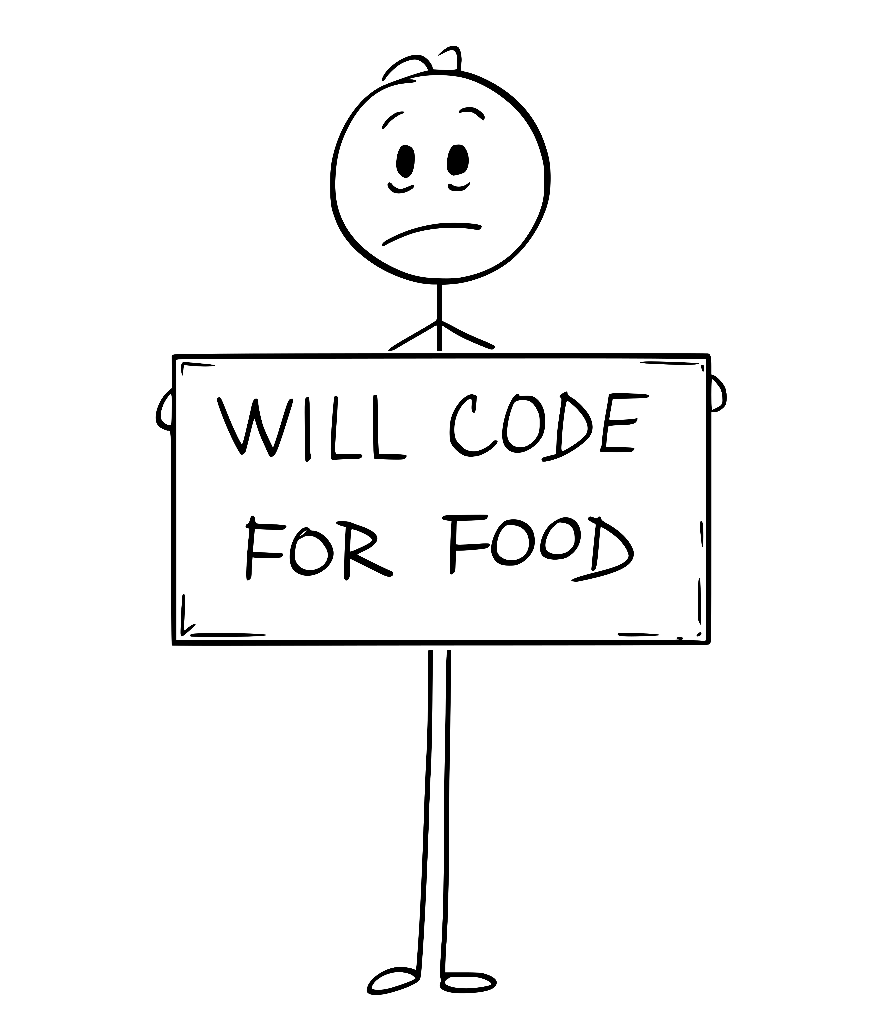
Notes:
I loved being on my own. The flexibility, the control. My kids have never really known anything other than dad being at home.
During this time, I had a variety of clients and worked on a variety of projects. A couple times I stepped in as a team lead for projects, but for the most part, I worked solo.

Slide 13
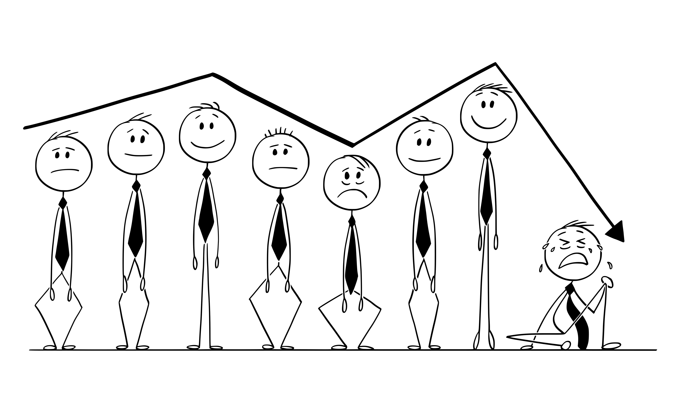
Notes:
If anyone is (or has been) indie, you know when the times are good, they're
good, but when the times are bad, they can be really bad. It was definitely a feast or famine lifestyle for those years.
In my time as an indie, I experienced a few famines, with one being really bad. That was back in 2006 and it's still hard to talk about. The famine that year was long. It was brutal. I ended up in a very dark place, but eventually came out of it, although not without scars.

Slide 14

Notes:
Within a month, I had a full-time job.
It was great. I was working on some really cool stuff with a fantastic team. I wasn't worried about where my money was coming from. After 14 years, it took
almost a year before the novelty of a regular direct deposit started to wear off. For that first year, on every other Friday I would announce loudly to my
wife that "I GOT PAID TODAY!" and I didn't need to call anyone to make it happen.
BTW, if you haven't seen the "F you, pay me" video on youtube, check it out.

Slide 15

Notes:
I was loving life. Great people. Cool work. Steady pay. It was awesome!

Slide 16
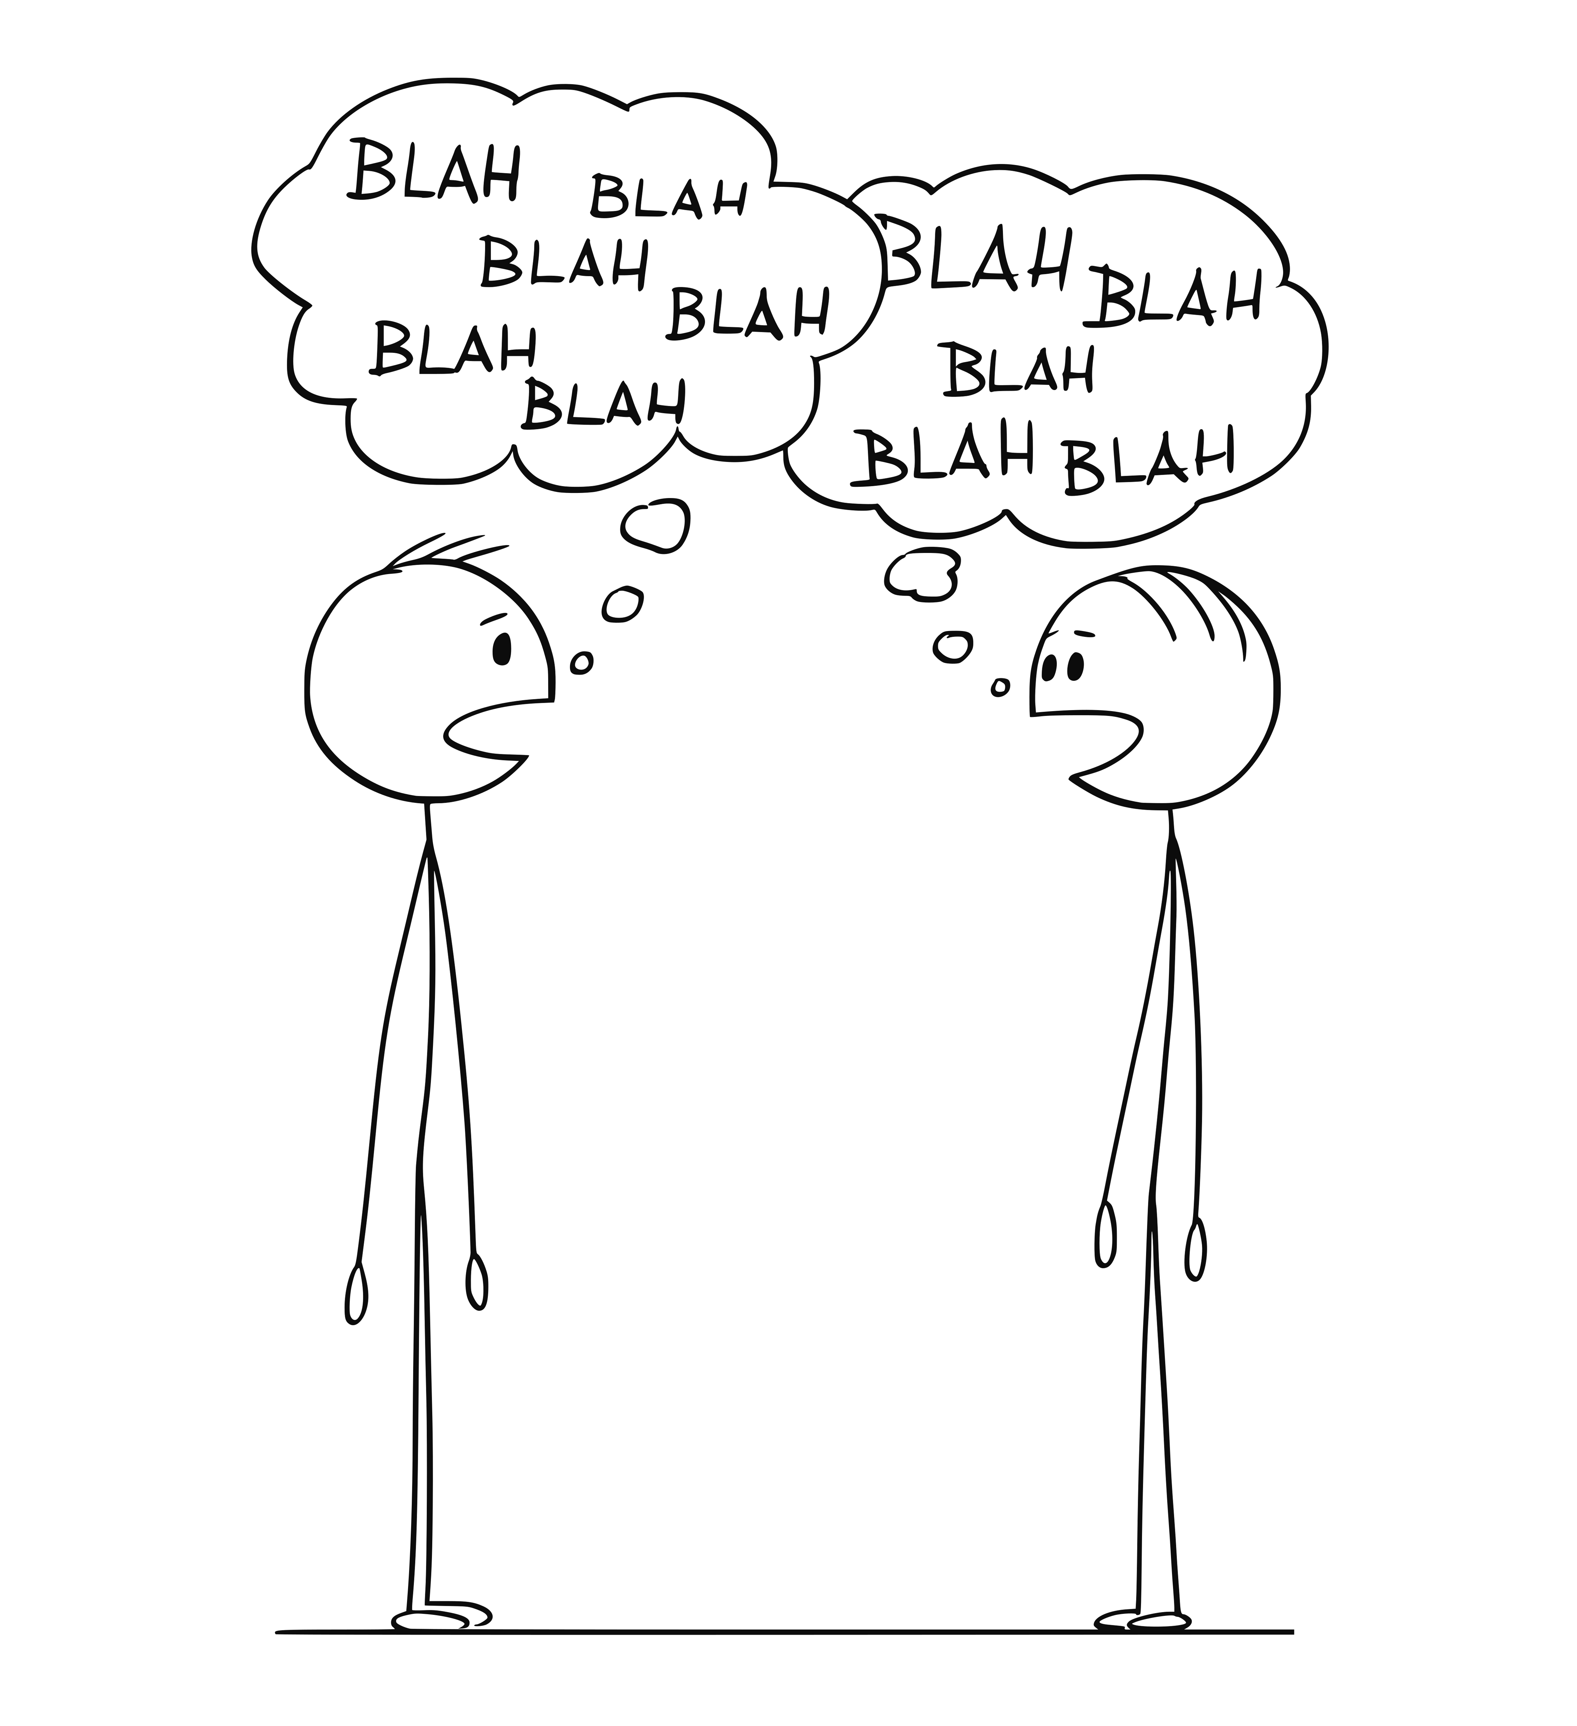
Notes:
Shortly after I started, my leader (the friend who responded to my email) started talking to me about leadership. A good leader is always looking for their replacement, and he knew that eventually
he'd move on to a different role and thought I would make a good leader for the team.
At first, I didn't really take the conversations seriously. The fact is, I was enjoying what I was doing. I went into the job saying
"I'll give it a year and then see if I want to stay, or maybe go back to being an indie."

Slide 17

NO!
Notes:
I initially said, "no", mainly because I simply needed to make it to that 1-year
milestone.

Slide 18
The first step in calculating which way to go is to find out where you are.
- Margaret Thatcher
Notes:
At my 1-year anniversary, I knew I was going to stick around. It was a great company. The team worked hard and played hard.

Slide 19
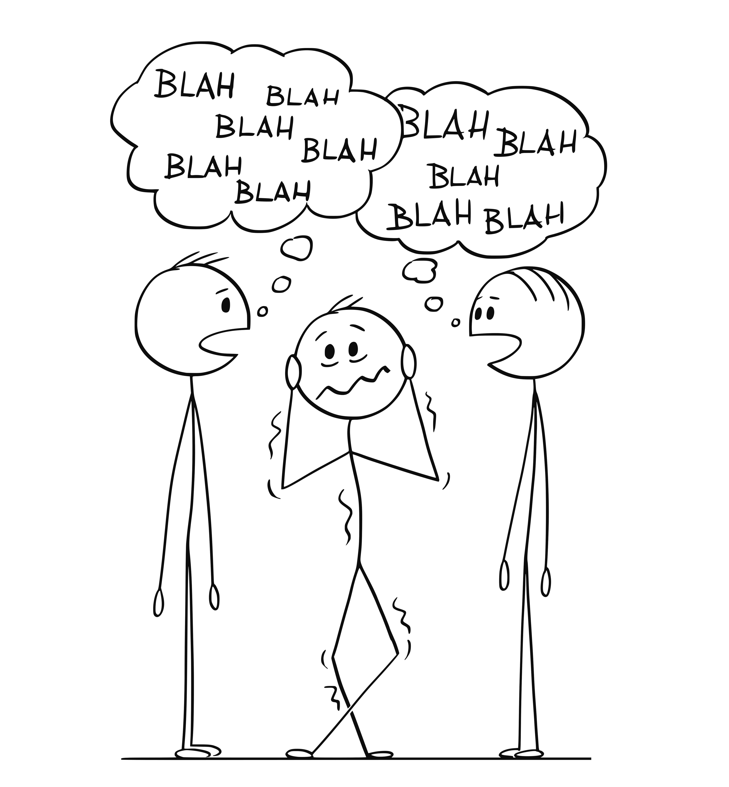
Notes:
Right around the time of my 1-year anniversary, I was out having drinks with my leader
and a friend. At some point during the conversation, my friend looked at my leader (they
were friends as well) and asked point blank, "so, when is mike gonna be a leader?"
My leader looked at me and said, "it's up to him".

Slide 20
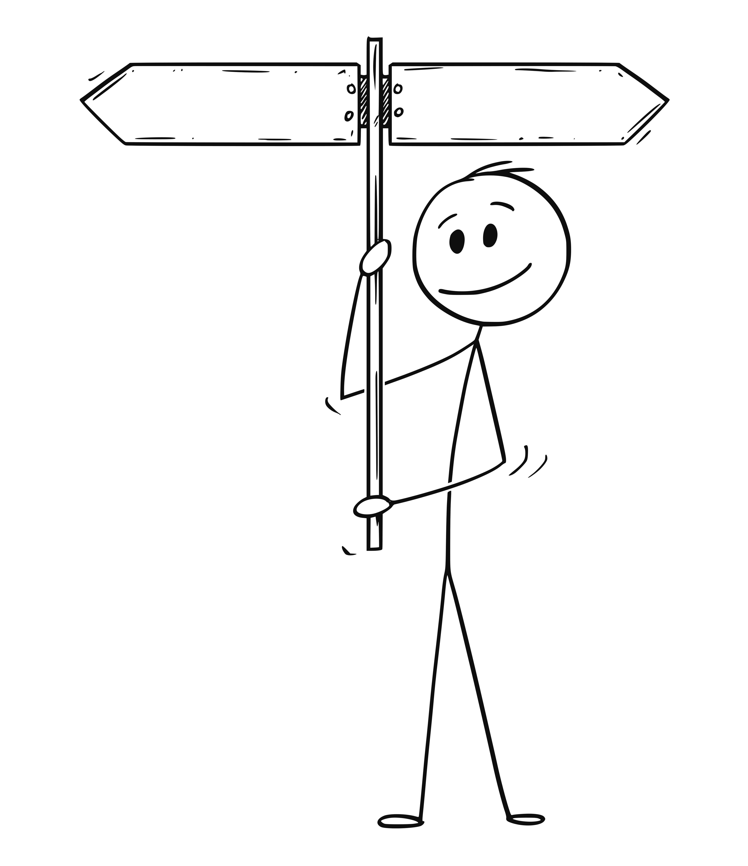
Developer
Leader
Notes:
I started to seriously consider it, but it still wasn’t a simple choice. I needed a Why.

Slide 21

Notes:
The Why is important. Just because he asked wasn’t enough. Just because he thought I would do a good job wasn’t enough. I needed more.
I spent a lot of time thinking about it.
I made pro/con lists. I talked to other leaders. I talked to friends and family.

Slide 22
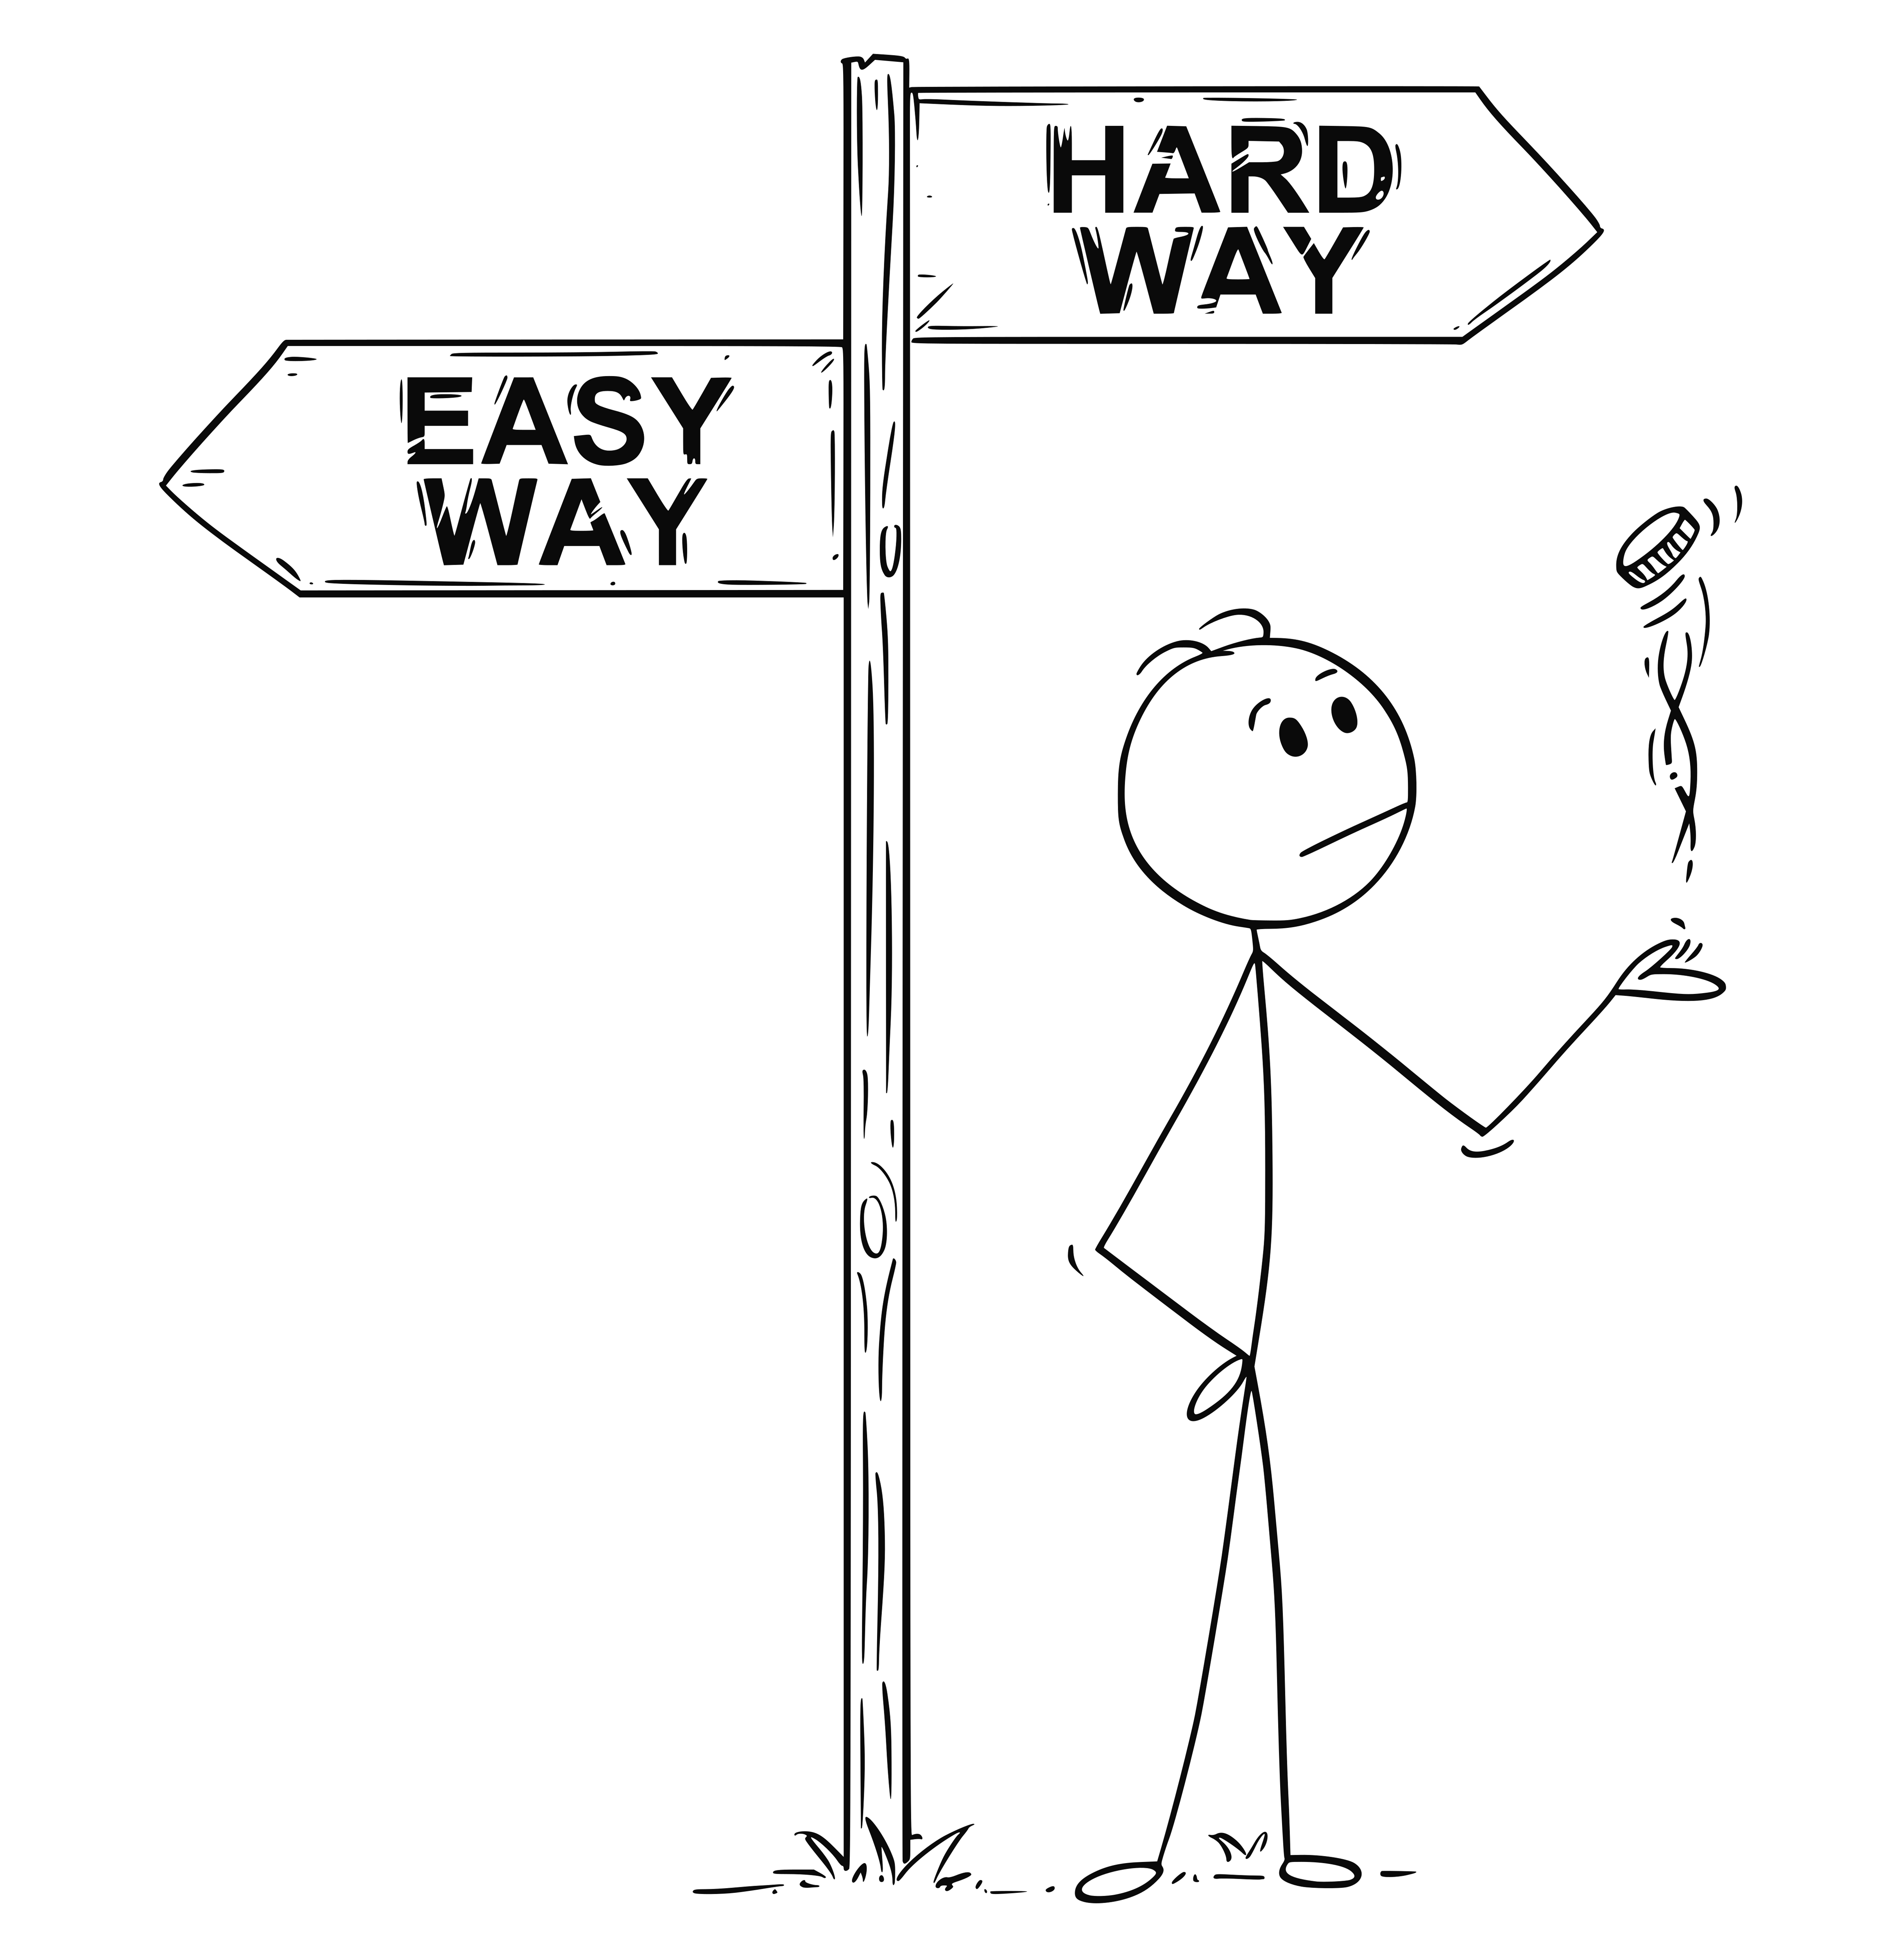
Notes:
I knew taking the role wasn’t going to be easy. There were risks involved.

Slide 23
Do all the good you can, for all the people you can, in all the ways you can, as long as you can.
- Hillary Clinton
Notes:
At some point, it hit me - I could do more for the team as their leader as I could a peer.
“Do all the good you can, for all the people you can, in all the ways you can, as long as you can.”
I had my Why, Why Not?

Slide 24
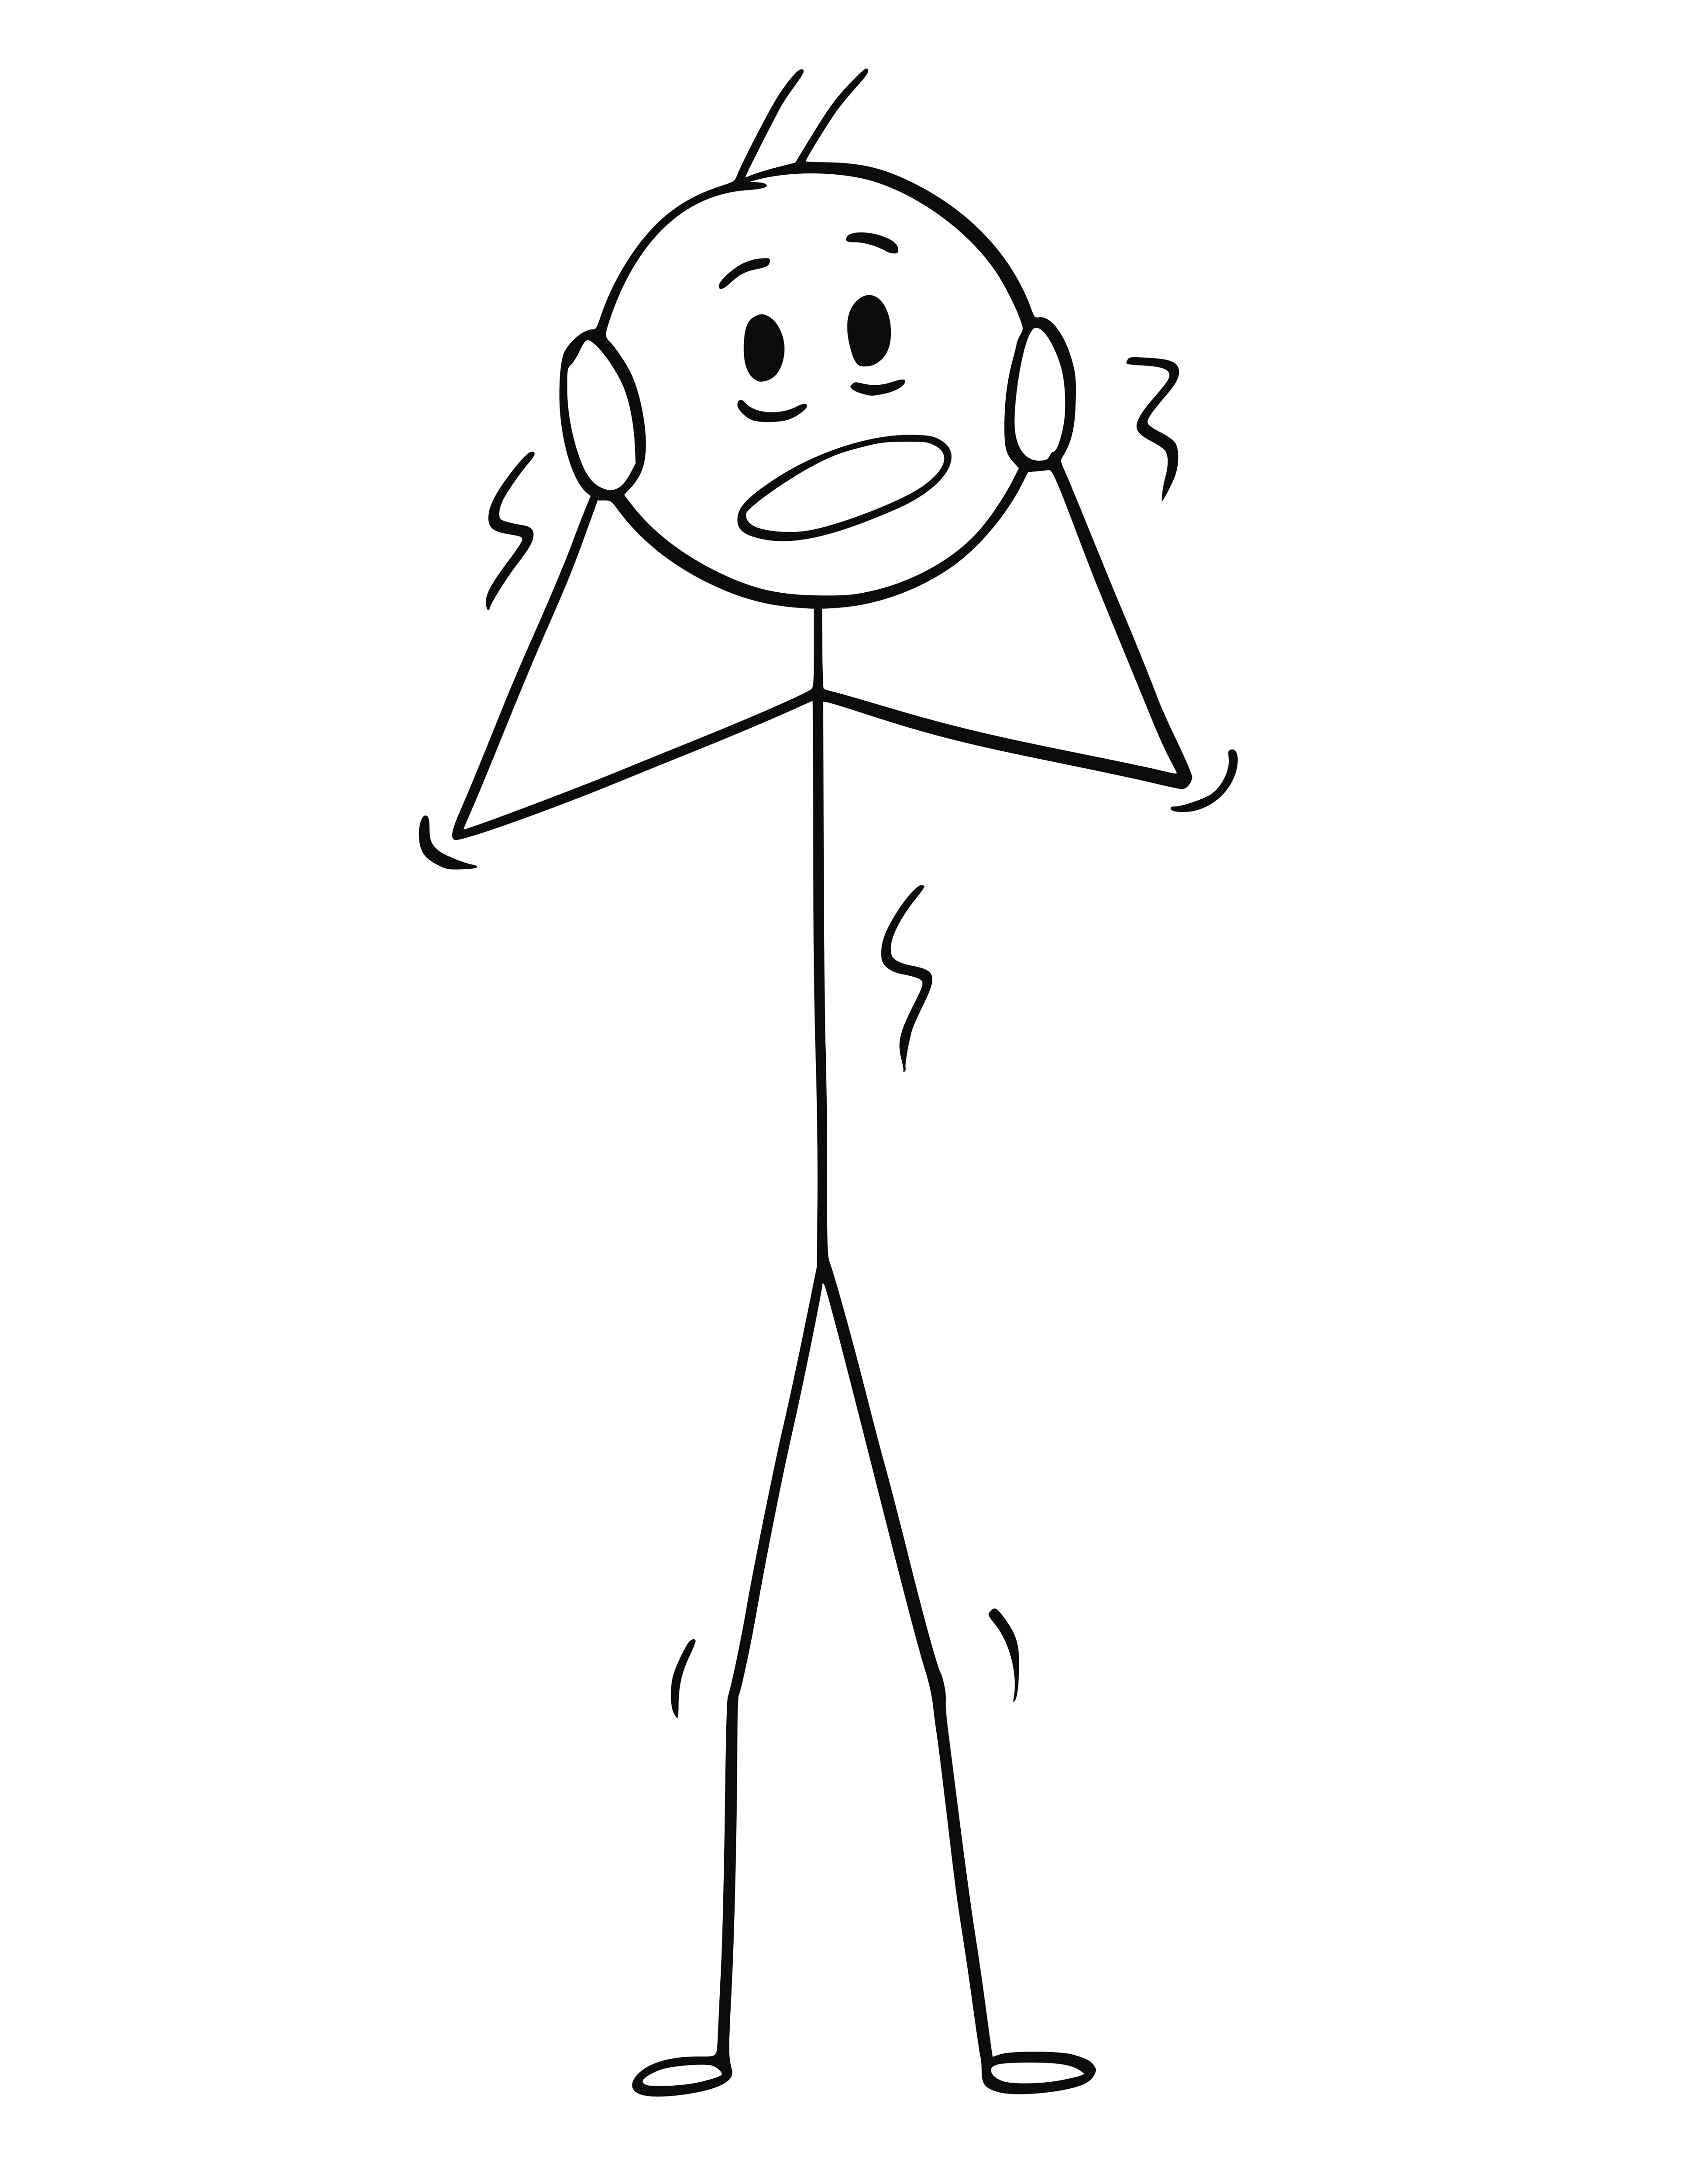
Notes:
Why Not?
Fear. What if I took the role and hated it. What if I took it and I sucked? What if I took it and my team hated me? What if I took the role and I hated me?

Slide 25
Research suggests that we tend to regret what we haven’t done much more than what we have done – even if we screwed up in doing it.
- Ben Hunt-Davis
Notes:
Research suggests that we tend to regret what we haven’t done much more than what we have done – even if we screwed up in doing it.
I eventually interviewed for the role and surprisingly turned out to be the best candidate.
In June 2016, I officially became the leader of the team I had started on 18 months earlier.

Slide 26
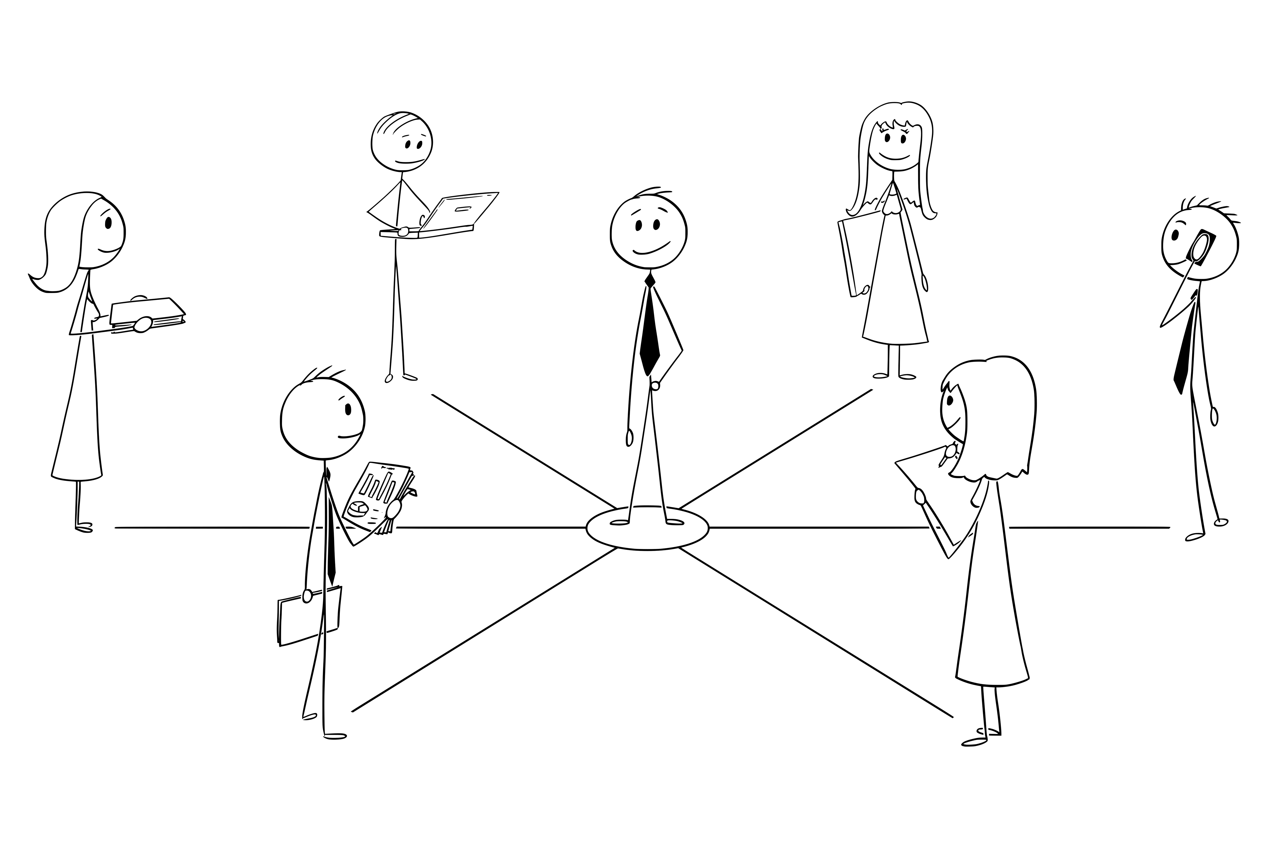
Notes:
The team seemed happy that I was stepping into the role and I was genuinely happy to be given
the opportunity.
Unfortunately, it wasn’t all sunshine and roses, and it certainly wasn’t rainbows and unicorns.

Slide 27
Challenges
Notes:
The team I was leading consisted of 6-7 senior developers, a senior BA and an intern. There was a
fair amount of dysfunction on the team, mainly brought on by the previous leader. Many issues had
festered over the months.
In fact, during the previous months, my leader would frequently ask me how I would handle some of the dysfunction. I think he was out of ideas and was looking for new ones.

Slide 28
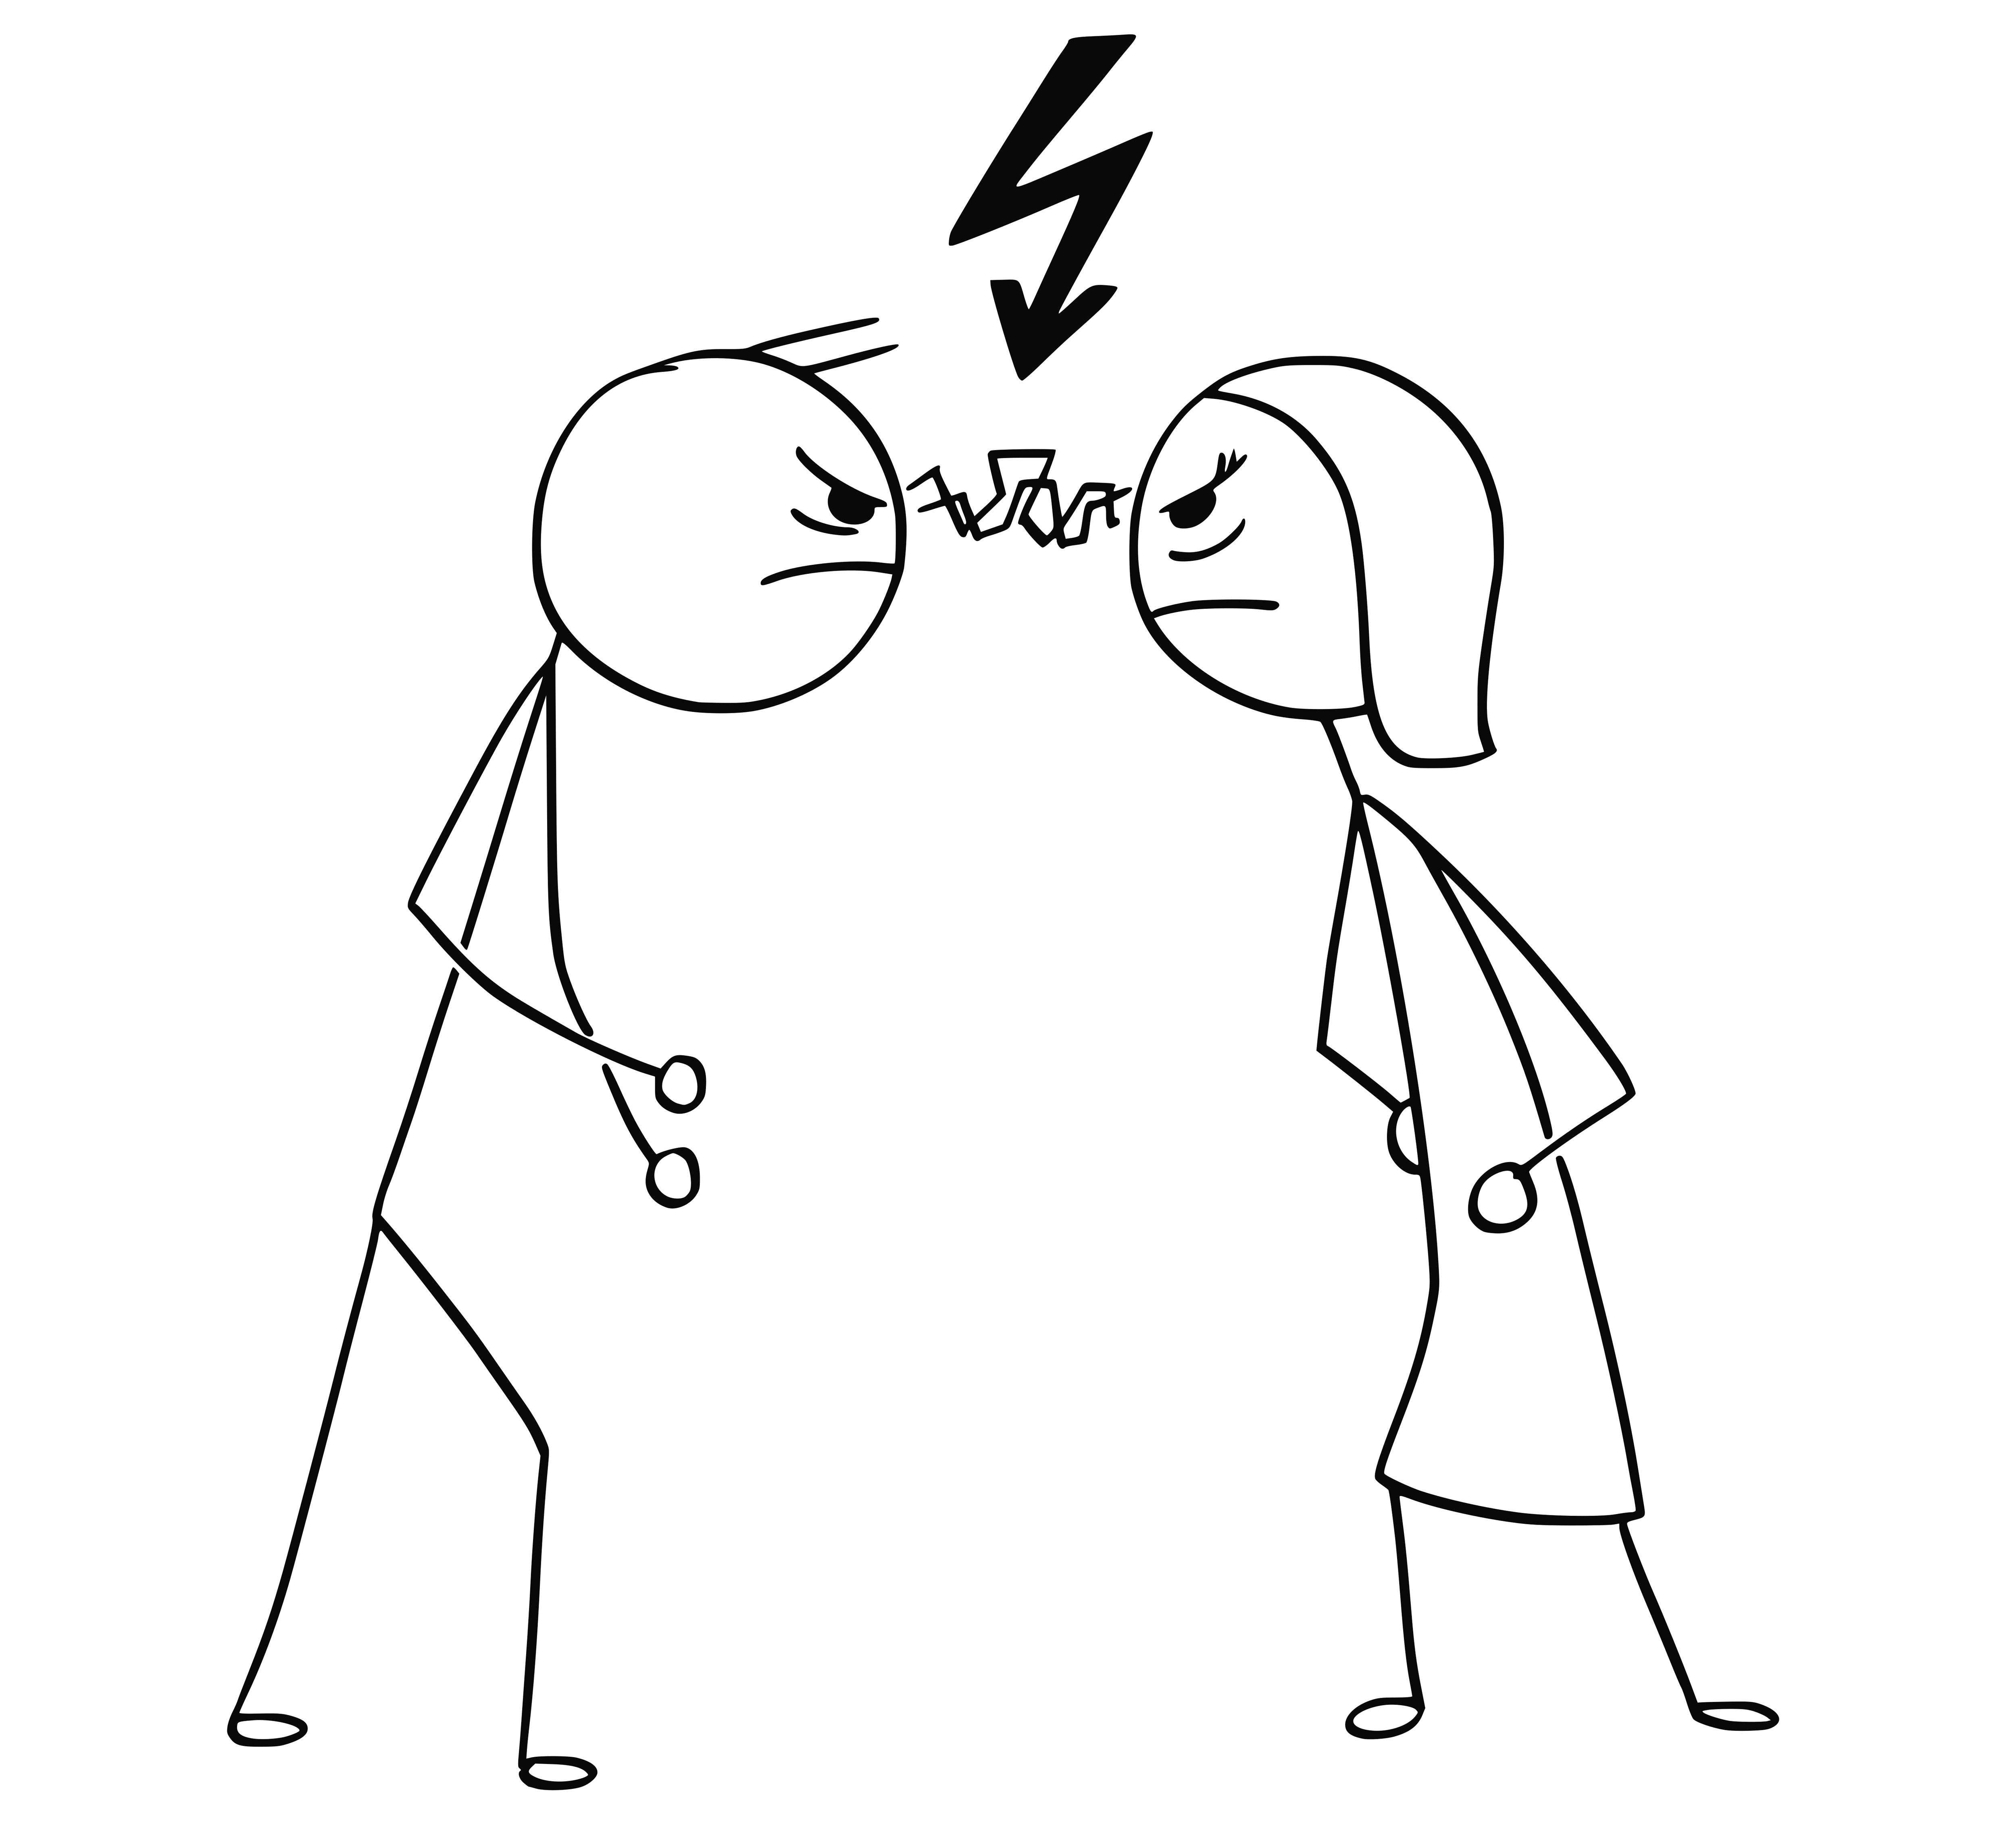
Notes:
On my first day as the leader of the team, there was an “incident”.
<explain what happened>
I made mistakes.

Slide 29
People are hard.
- Every Leader Ever.

Slide 30
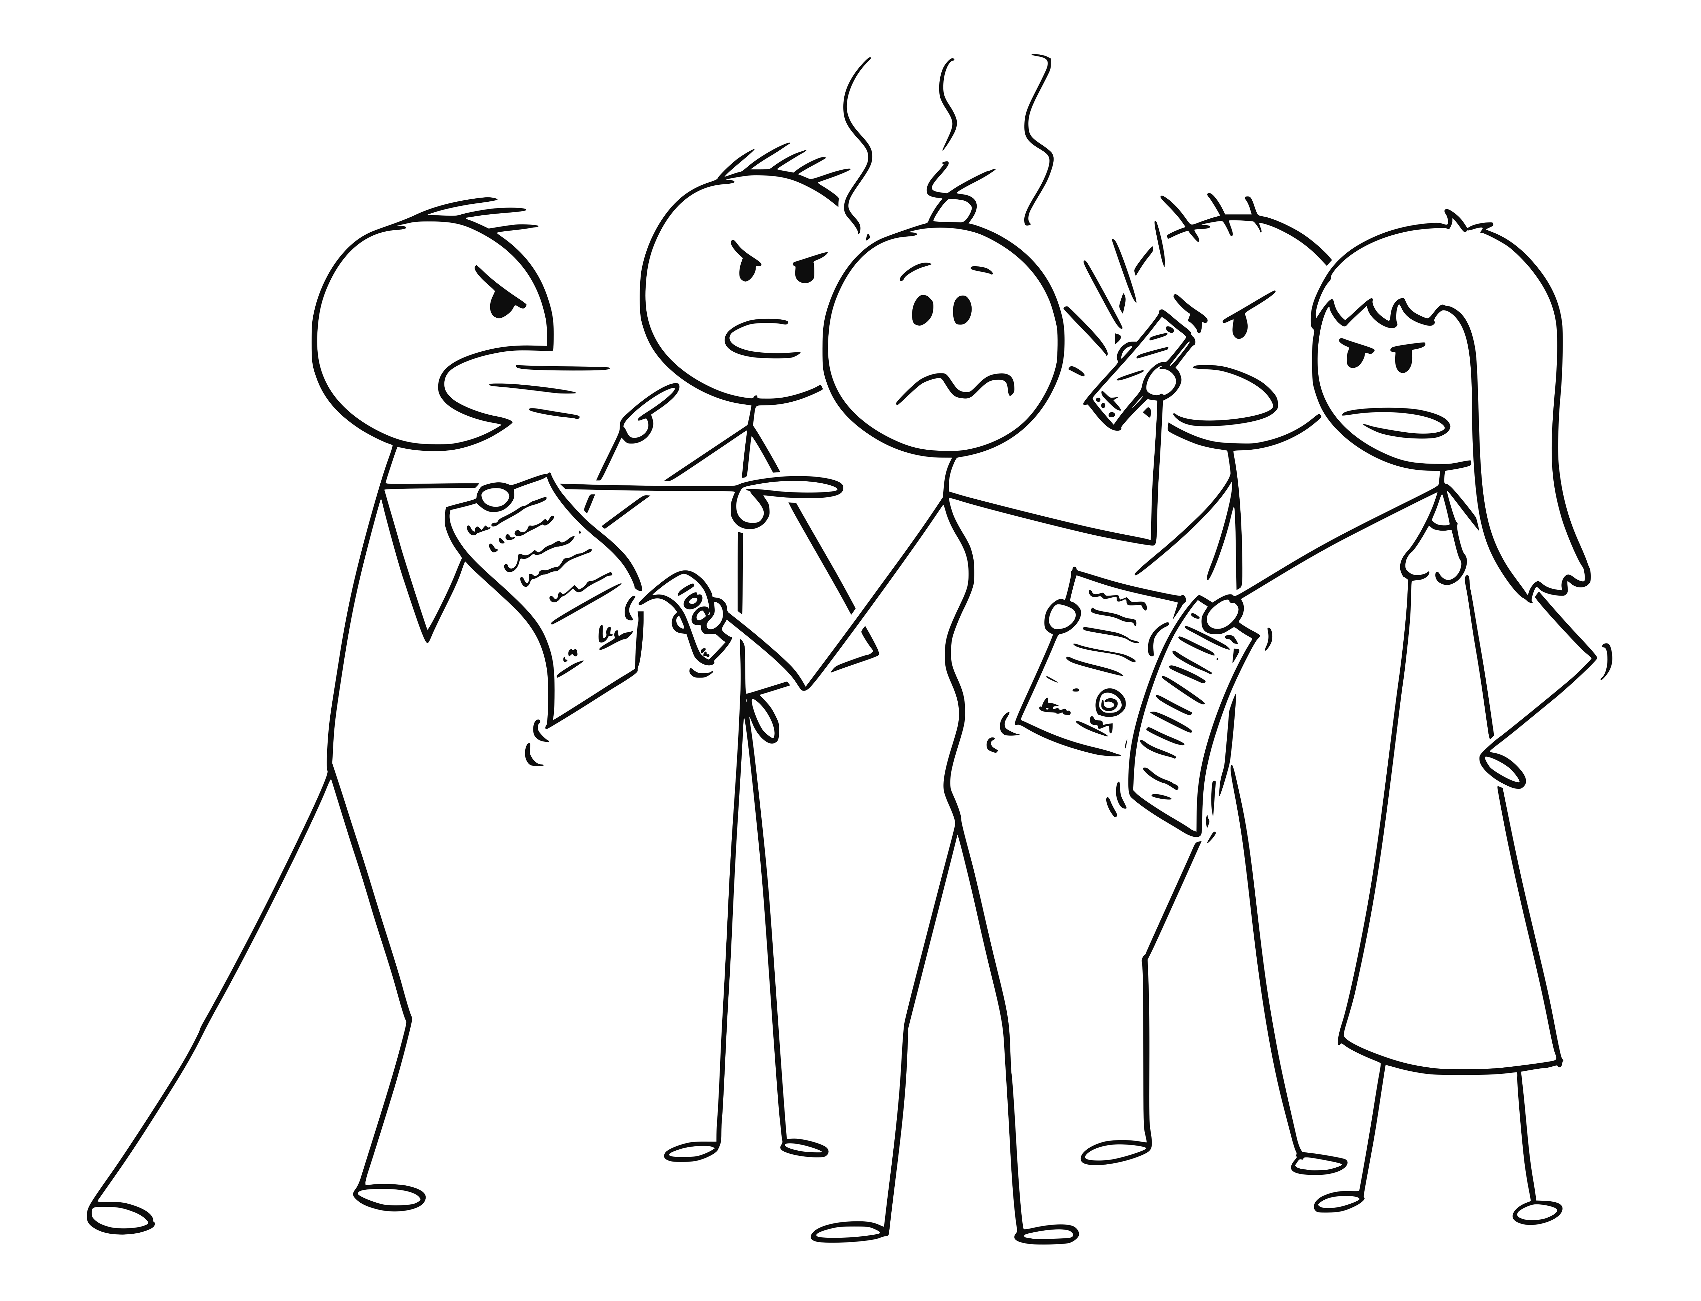
Notes:
You can’t make everyone happy. While my team was generally easy to deal with, there was a definitely forming and storming phase. I had to figure out how to make the transition from coder to leader. I also had to figure out how to figure out how to navigate the “we’re friends, BUT I also know how much you make” issue.
I had to have some difficult conversations.
Talk about being Amanda’s advocate (tie it back to servant leadership)

Slide 31
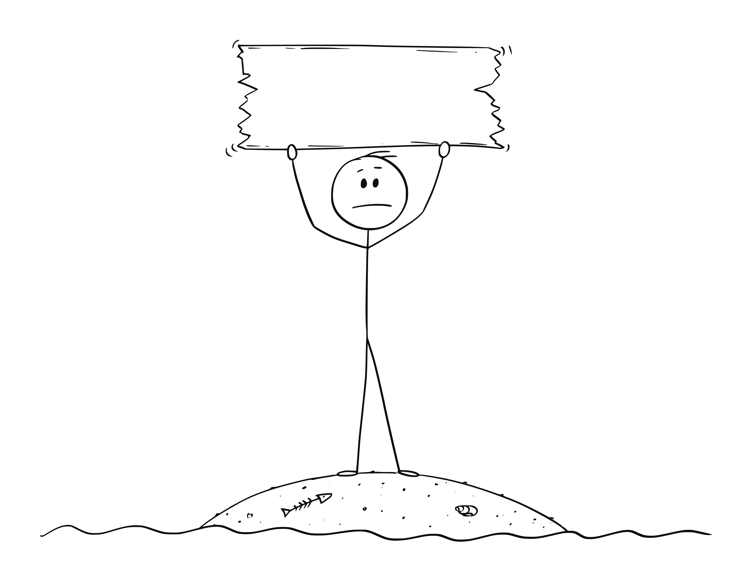
Remote
Leadership
Notes:
Not only was I a leader, I was also remote which brings a whole bunch of other challenges.
Frequent 1:1’s, but on the phone, sometimes with video. Can’t see body language.
Not around for the day-to-day banter.

Slide 32
Good times, bad times

Slide 33
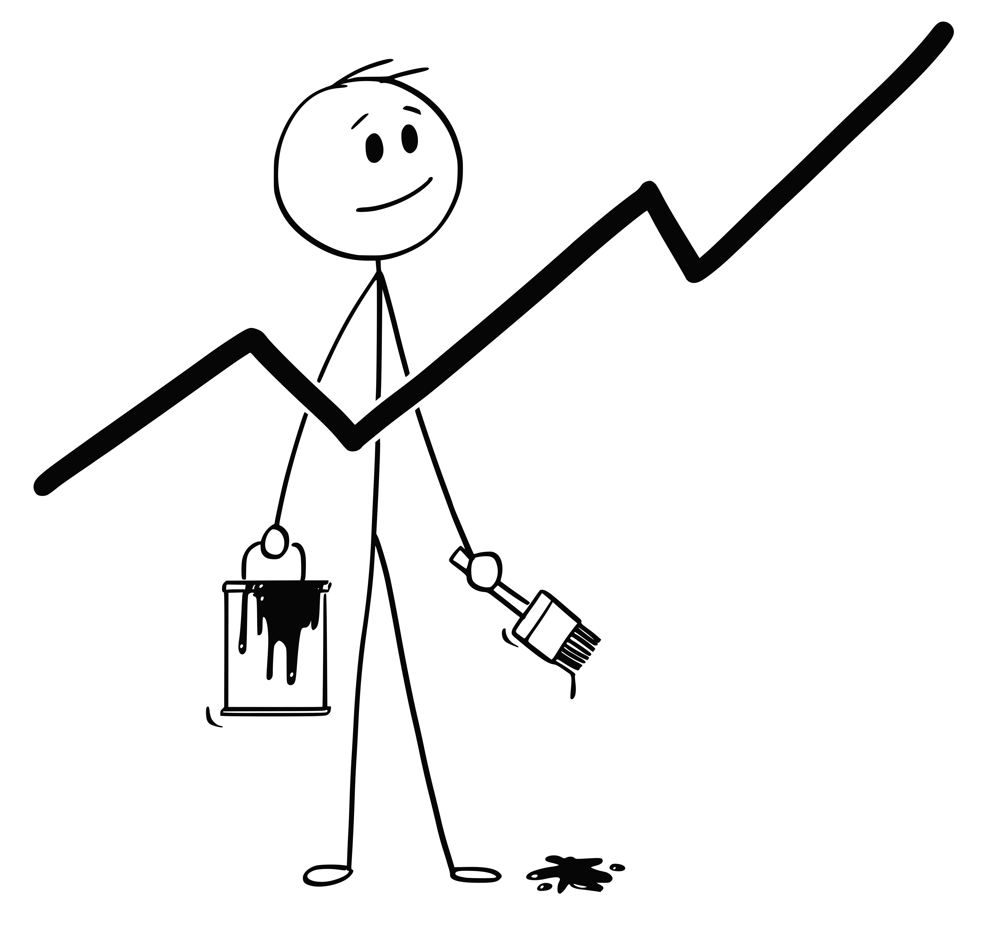
Notes:
The feedback from my team and from my peers was always extremely positive. A survey that was sent to all team members a couple times a year asking about leadership (and the company) was definitely an upward trend.
In one survey, I had 100% team participation (which wasn't necessarily the norm at the company) AND our team relations specialist (think HR) said I had some of the highest scores she'd seen.
Things were good.

Slide 34
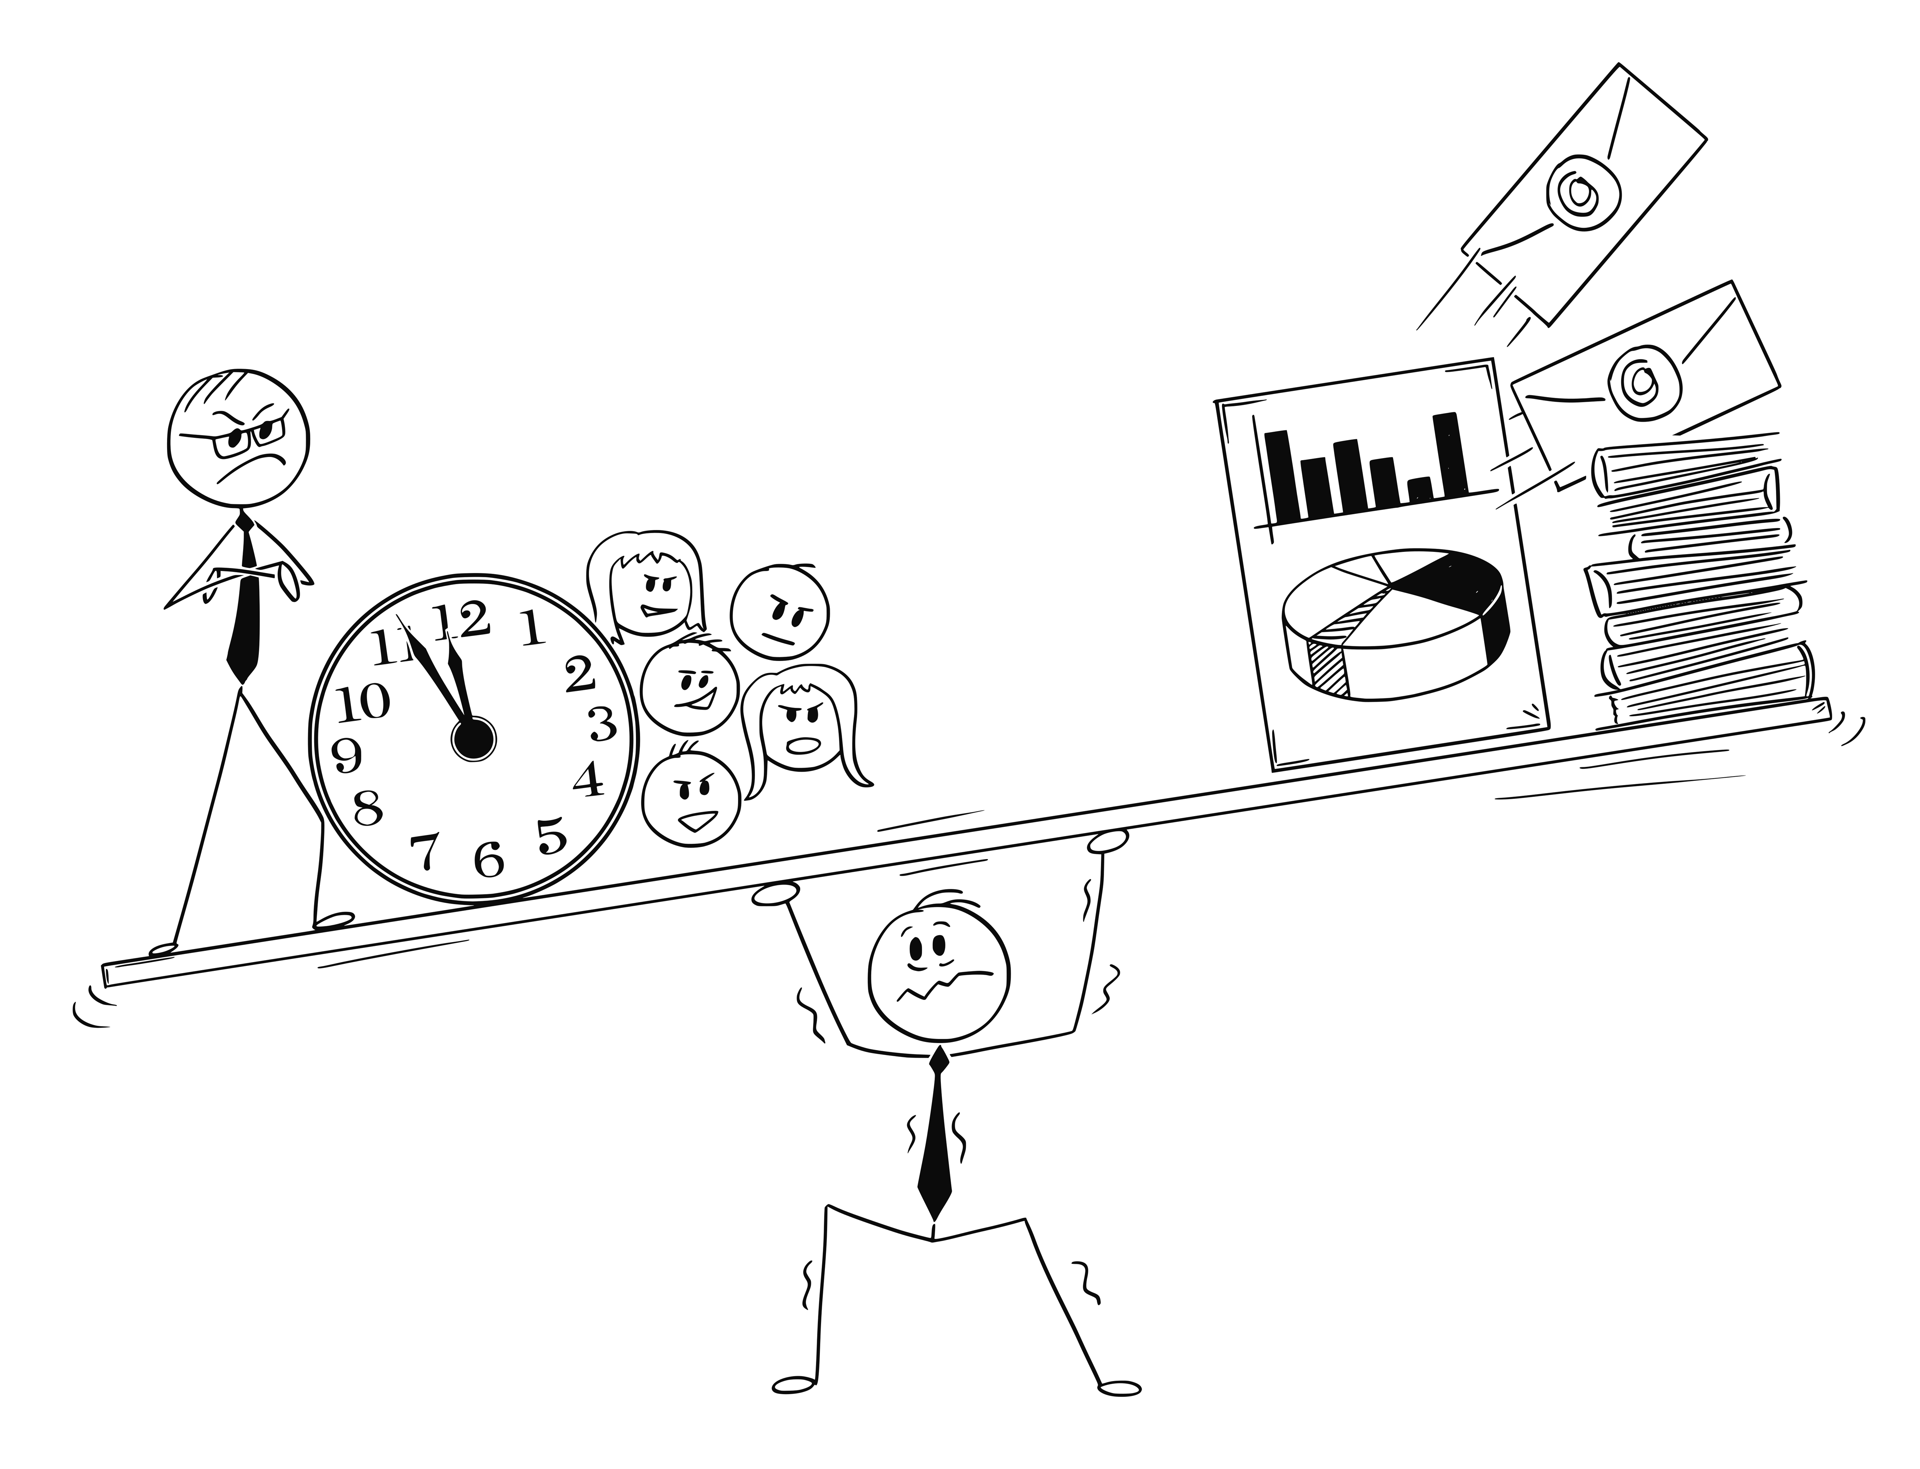
Notes:
I had a lot of things to do – my schedule changed from mostly coding to mostly Outlook and chat and meetings.
Many days were solid meetings, with very little "doing".

Slide 35
Leadership Development
Notes:
I was lucky in that this company invested a LOT of time and money into its leaders. From the start, aspiring leaders had a path. In fact, in the months leading up to my leader interview, I started taking courses on leadership – they were focused on leading myself because if you can’t leader yourself, how can you lead a team.
This particular course focused on a time management, SMART goals, how to write emails, how to leave a good voice mail, etc.
After I became a leader, I was immediately enrolled in an 8-month course where I was randomly grouped with other new leaders. I had never met them before that day. In the first 2 minutes we had to come up with a team name. In the next two minutes, we had to come up with a touchdown dance. Yea, it was as dumb as it sounds. I have no problem at all getting up in front of a group like this, but do NOT ask me to get up in front of a large group and act silly.
Over the course of the 8 months, we had classes on leadership, emotional intelligence, diversity and more. We also had assignments.
There was a competition among all the different teams (6 total teams). In the end, it was a great experience.
One of the other things I did when I took on the new role was to sign up for a leadership coach. (Talk about Martin)

Slide 36
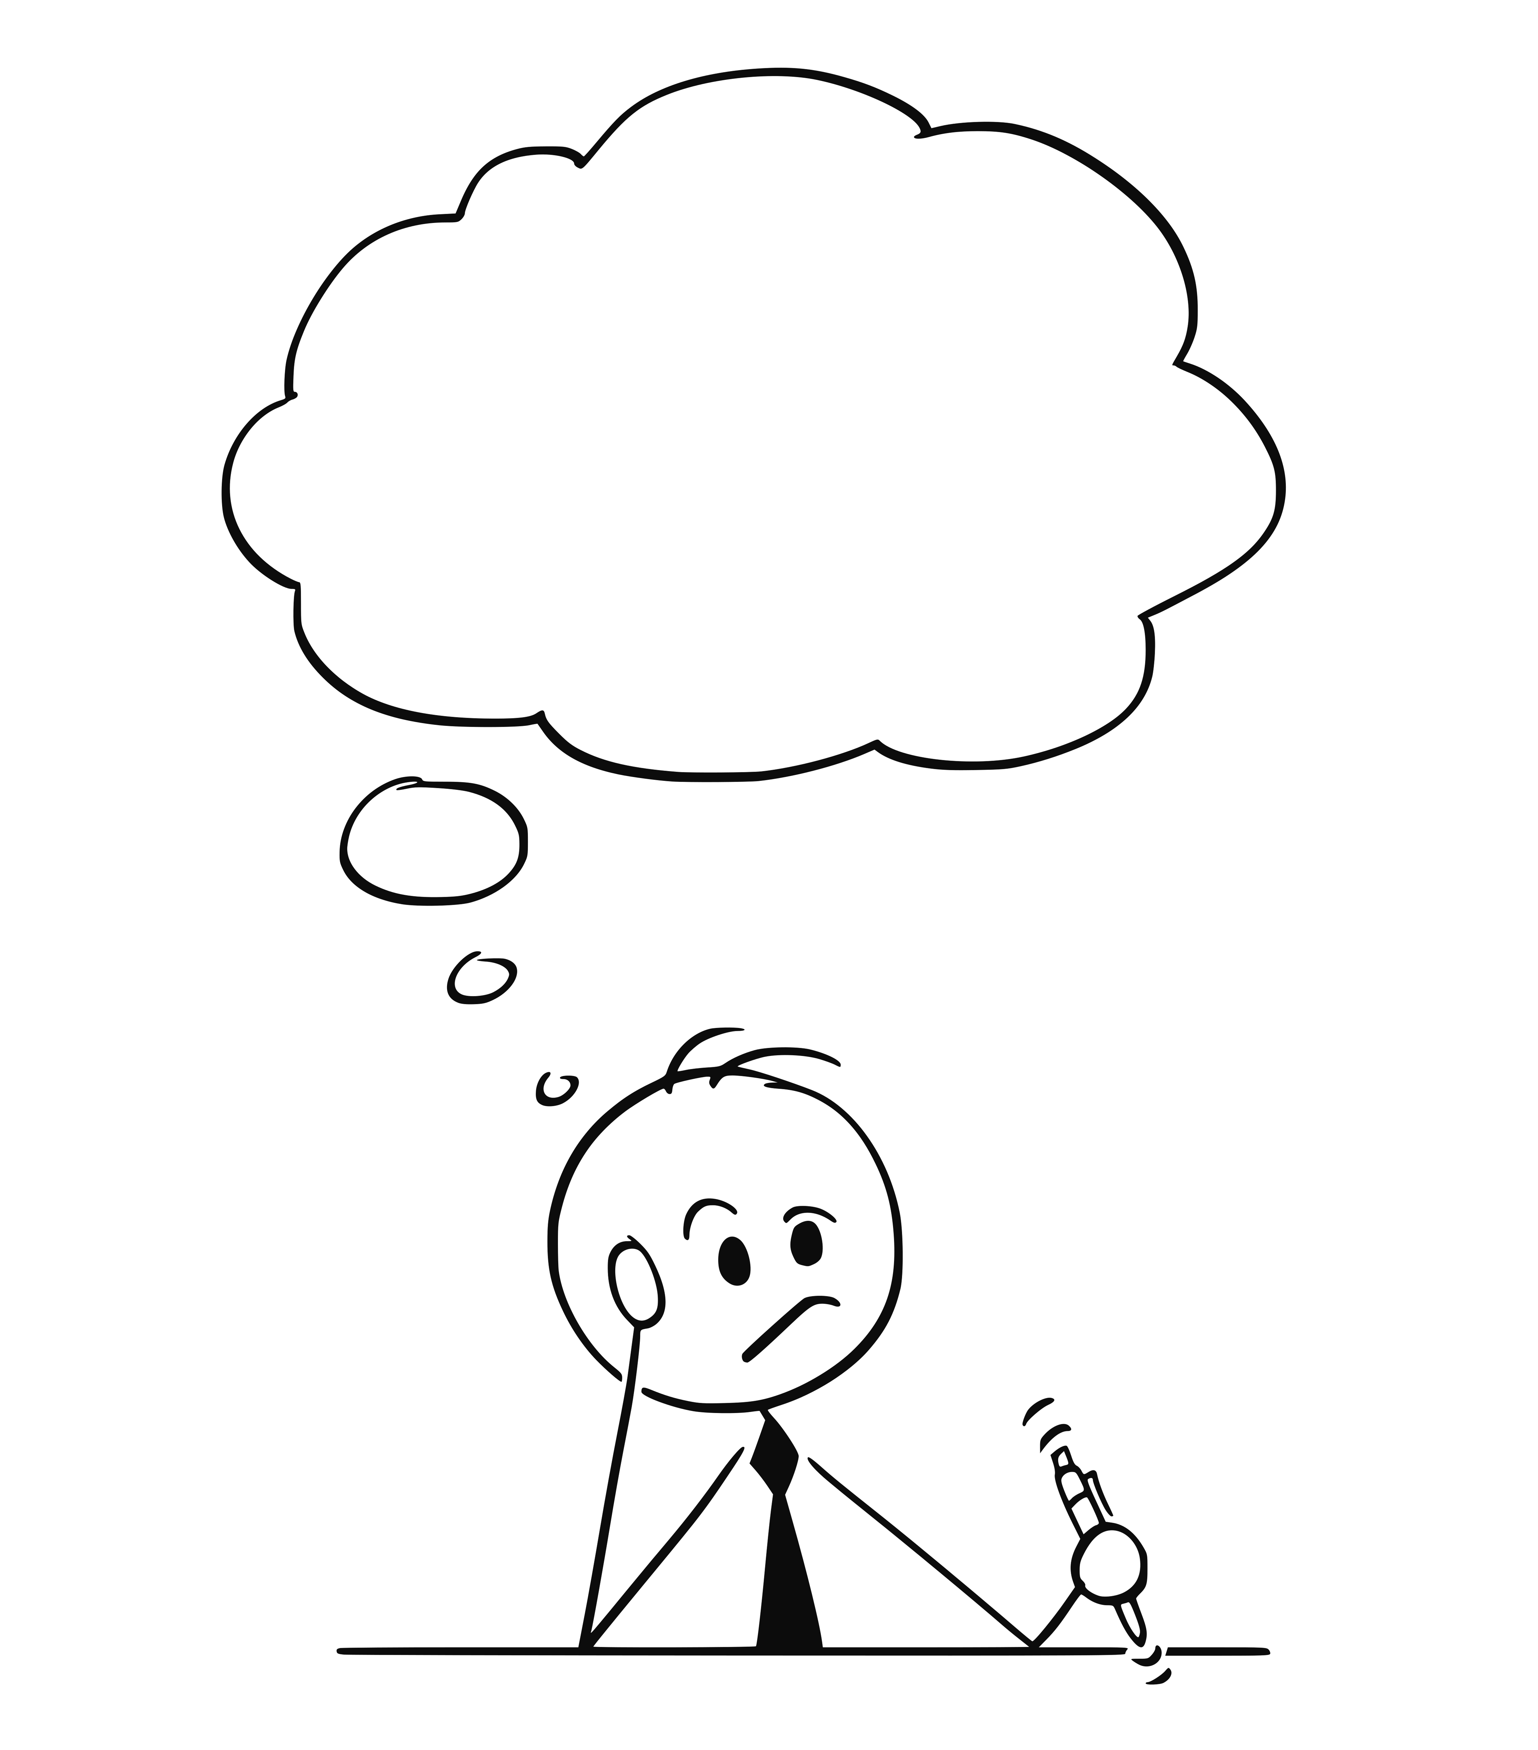
Why did I stop
coding?

Slide 37
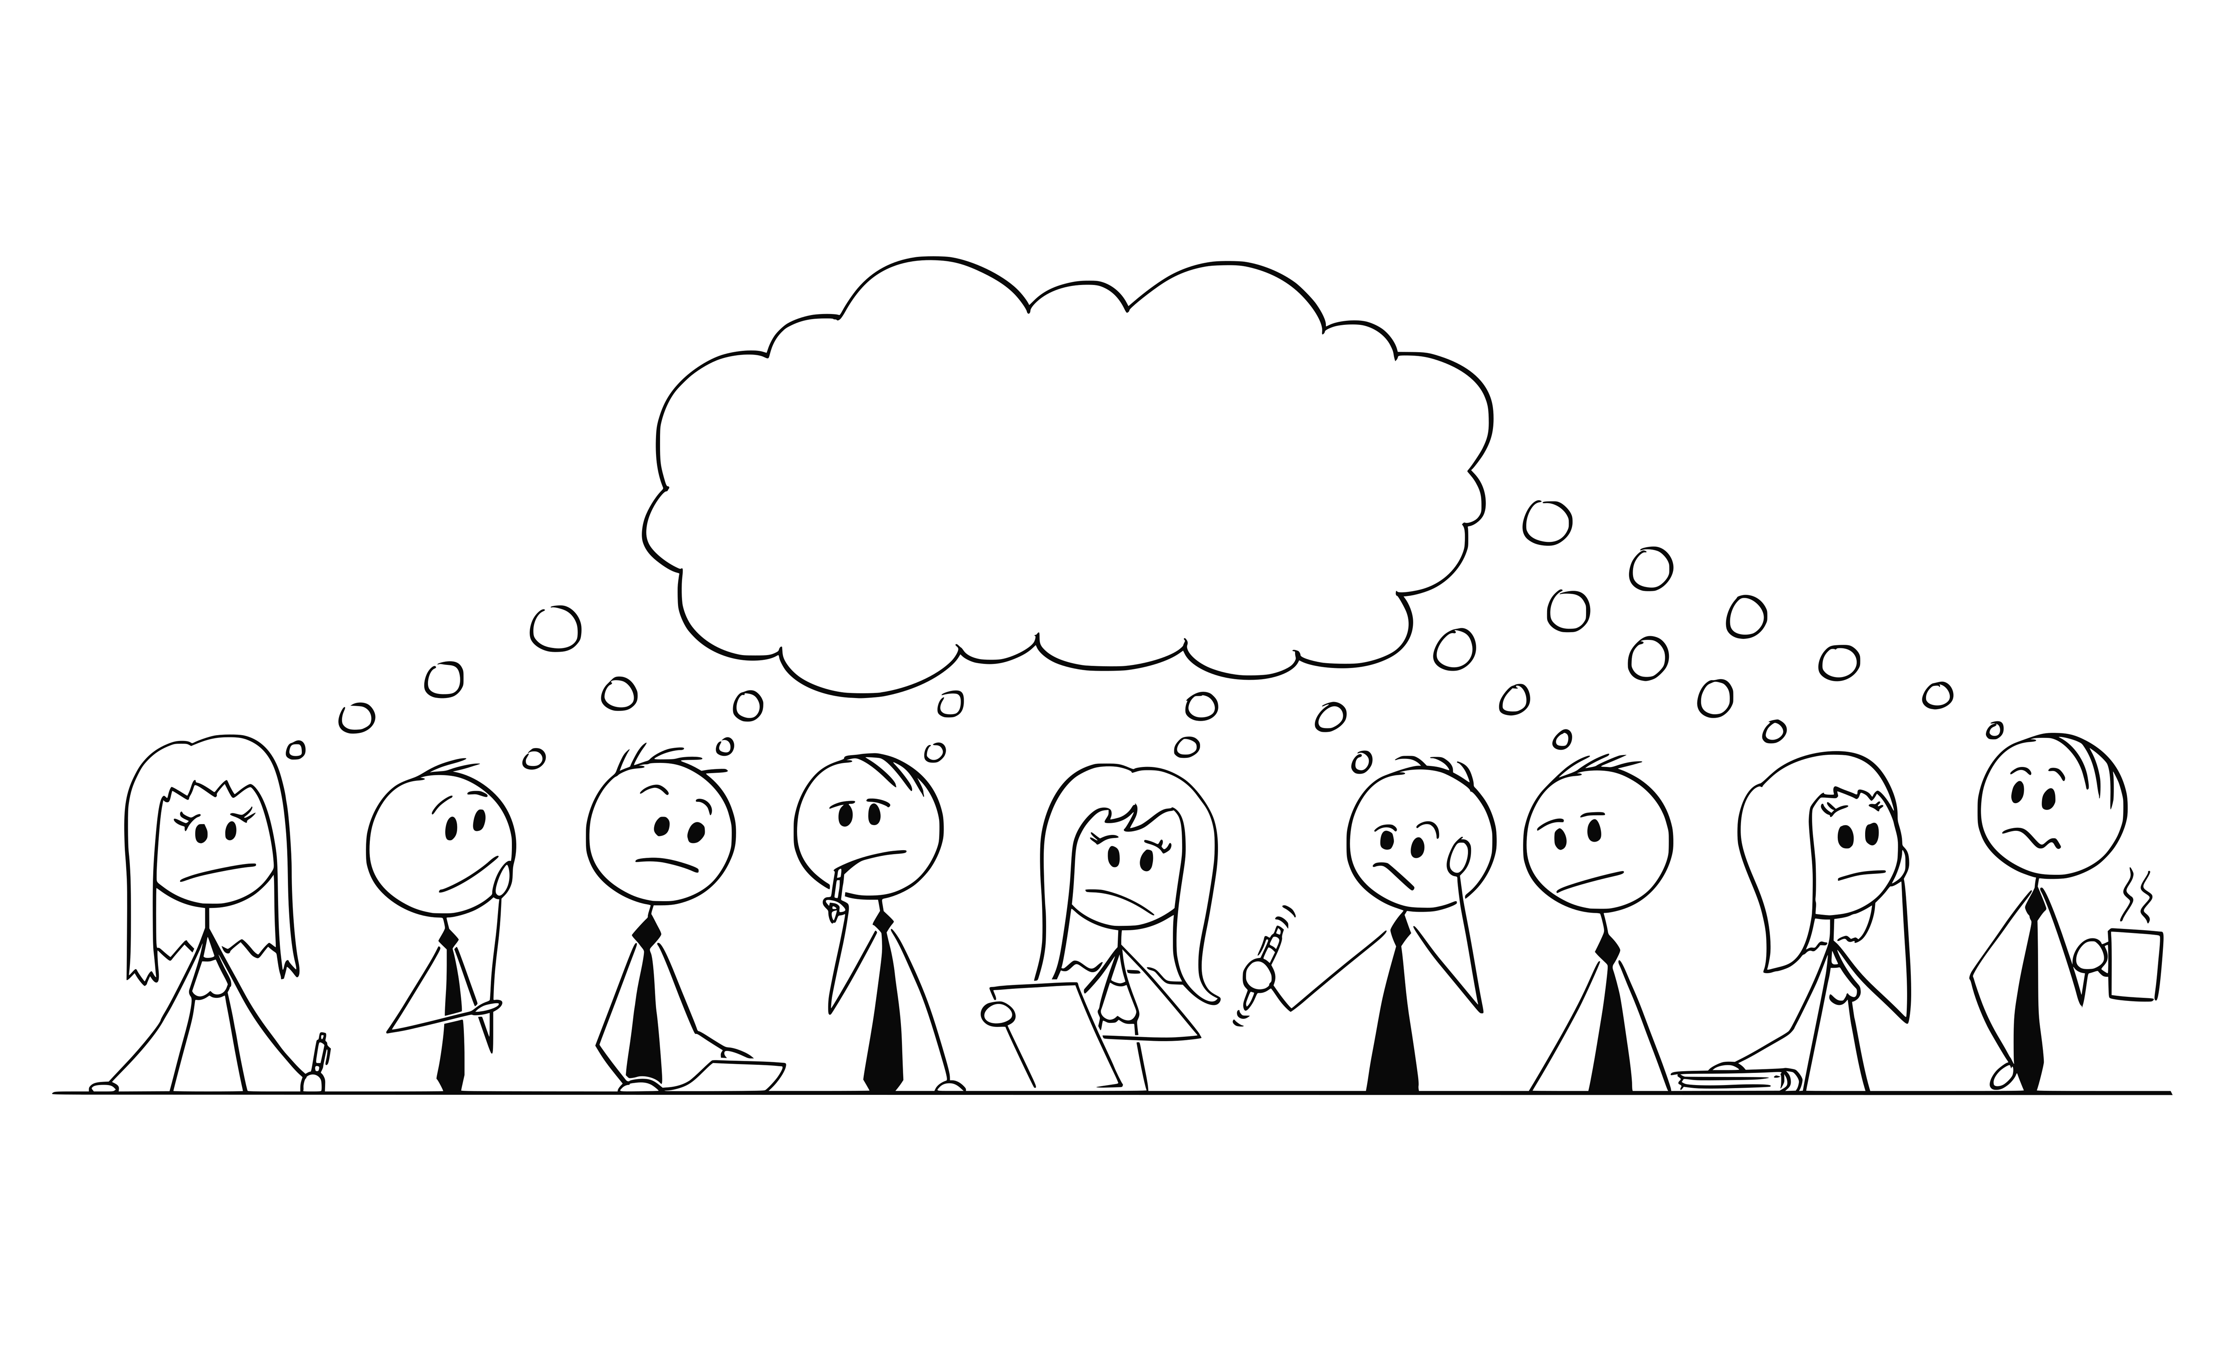

Slide 38
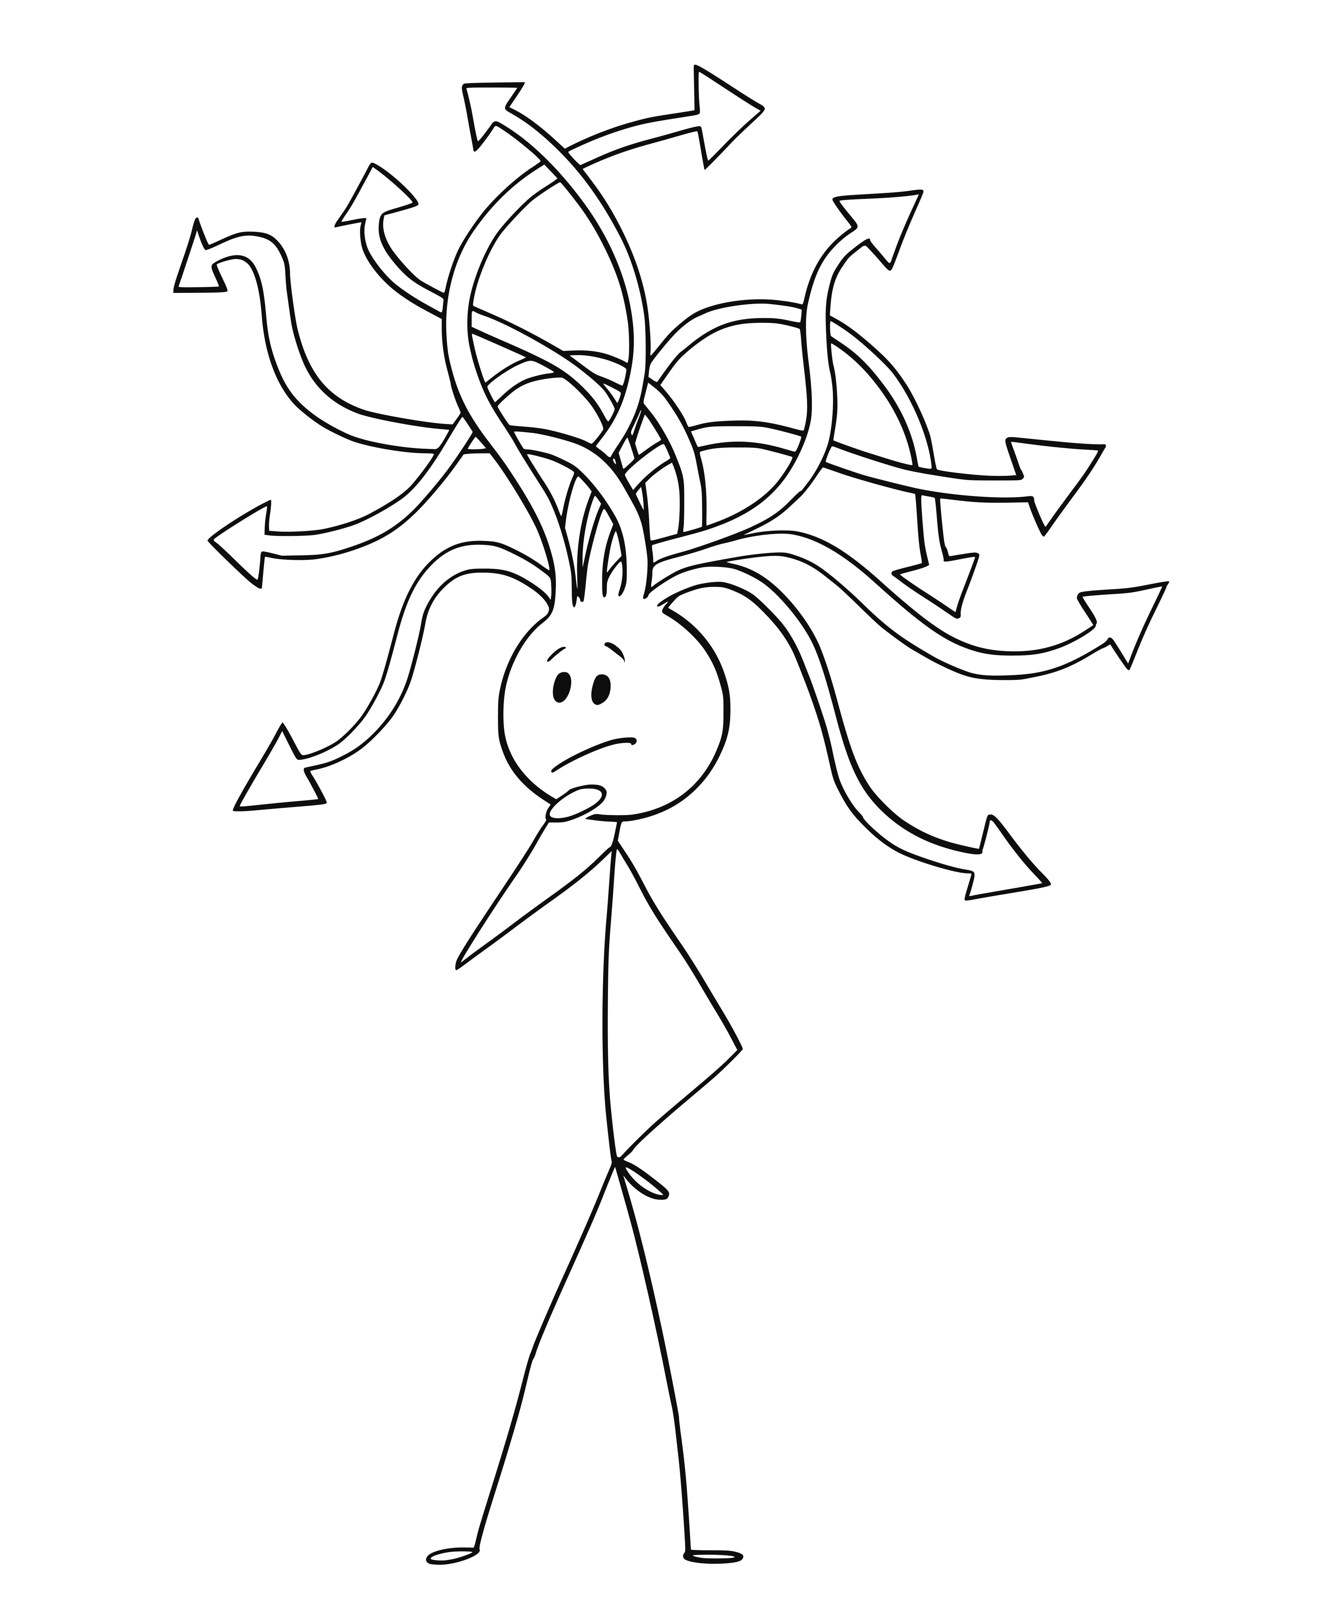

Slide 39
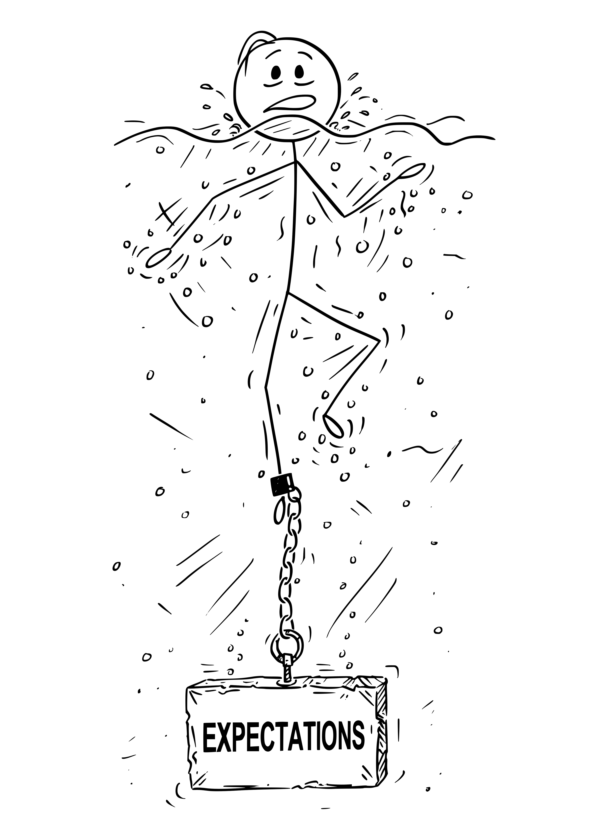
Notes:
Leading my team was never that difficult. Working with my peers was always a good experience.
Leading up was different. I struggled with the expectations that I do more, that I get involved in larger initiatives, that I DRIVE something.

Slide 40
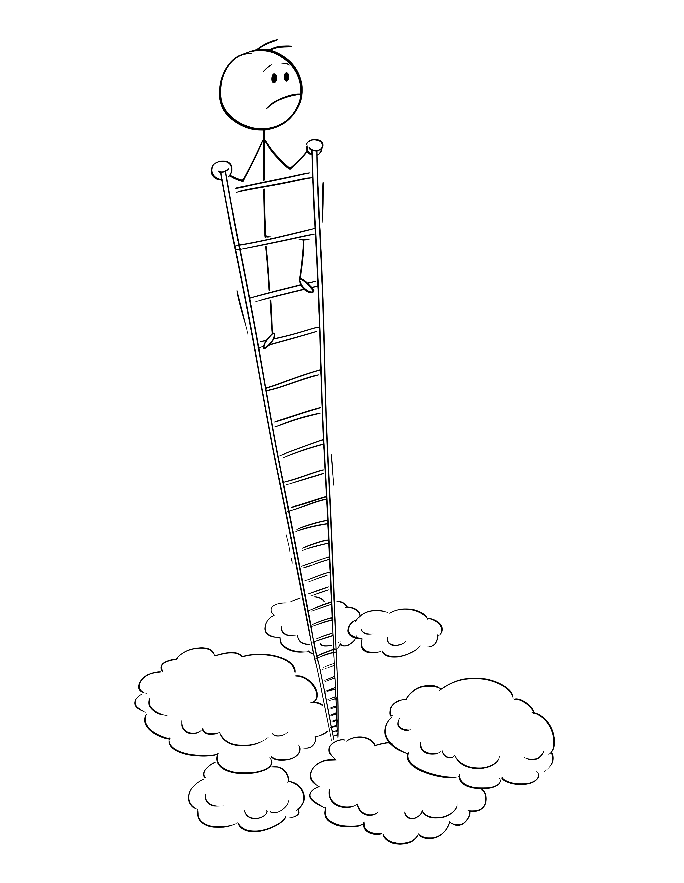
Notes:
I didn’t want to climb any ladders. I just wanted to lead my team.

Slide 41
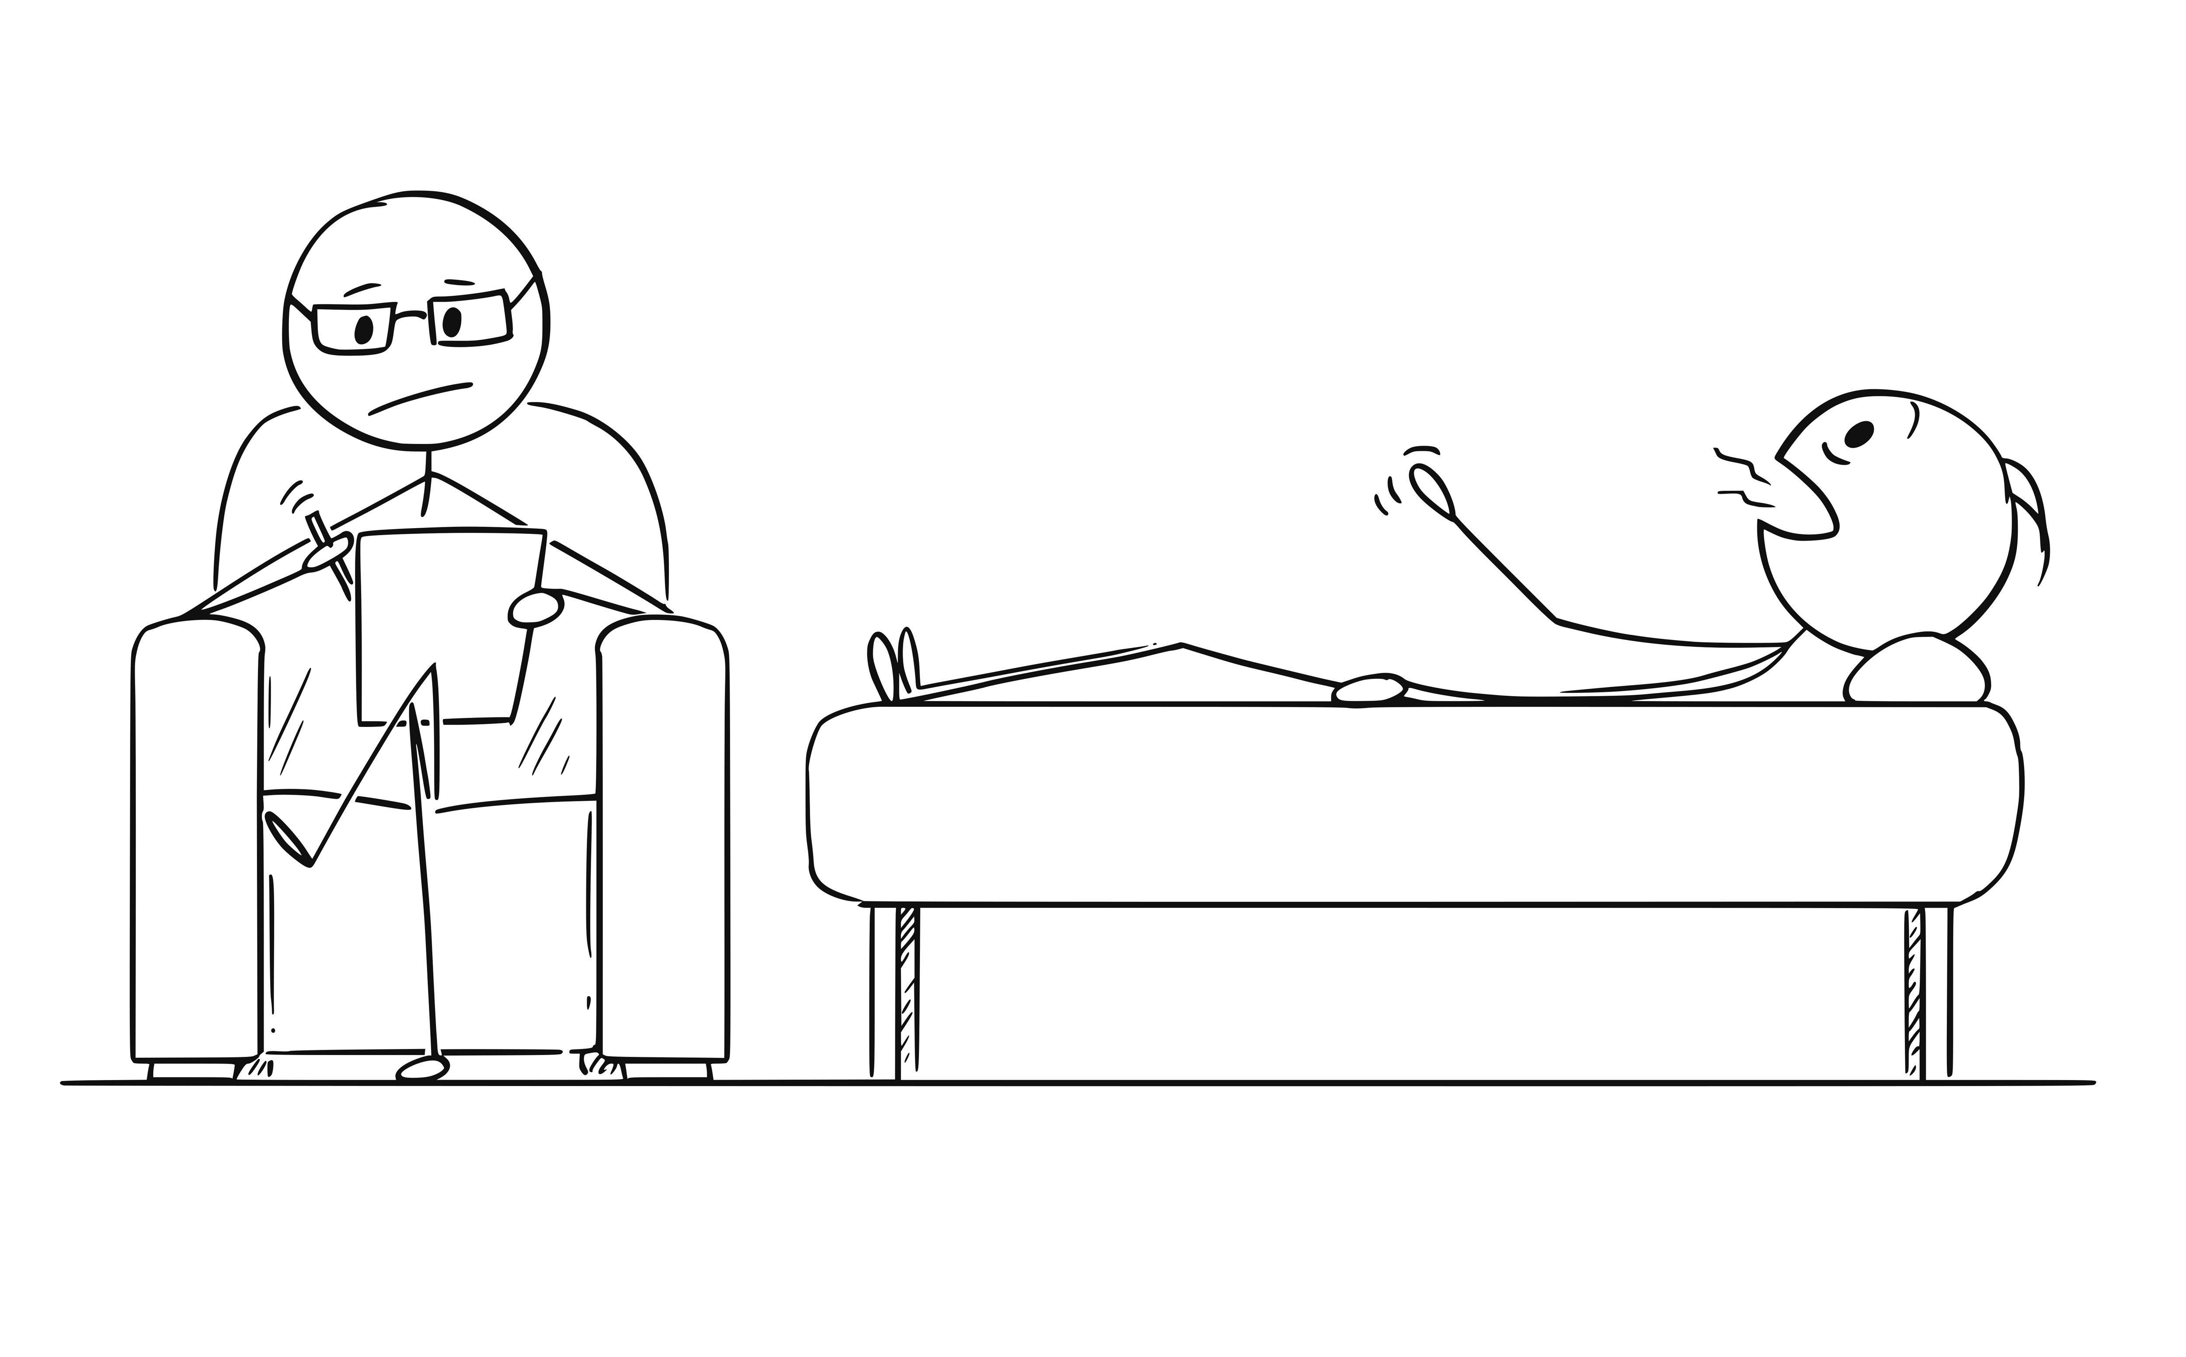
Notes:
Ok, so, here's where it gets a little more personal. Turning 30 didn't bother me. Turning 40 didn't bother me. Turning 45 was different, and I turned 45 at about the 18-month mark as a leader on the team. I realized I was firmly middle age IF I live to be 90. I can't kid myself about this anymore. This led to a lot of difficult questions about life and work. What did I really want to be doing - with life and with work. I melted down - that mid-life crisis thing is real.

Slide 42
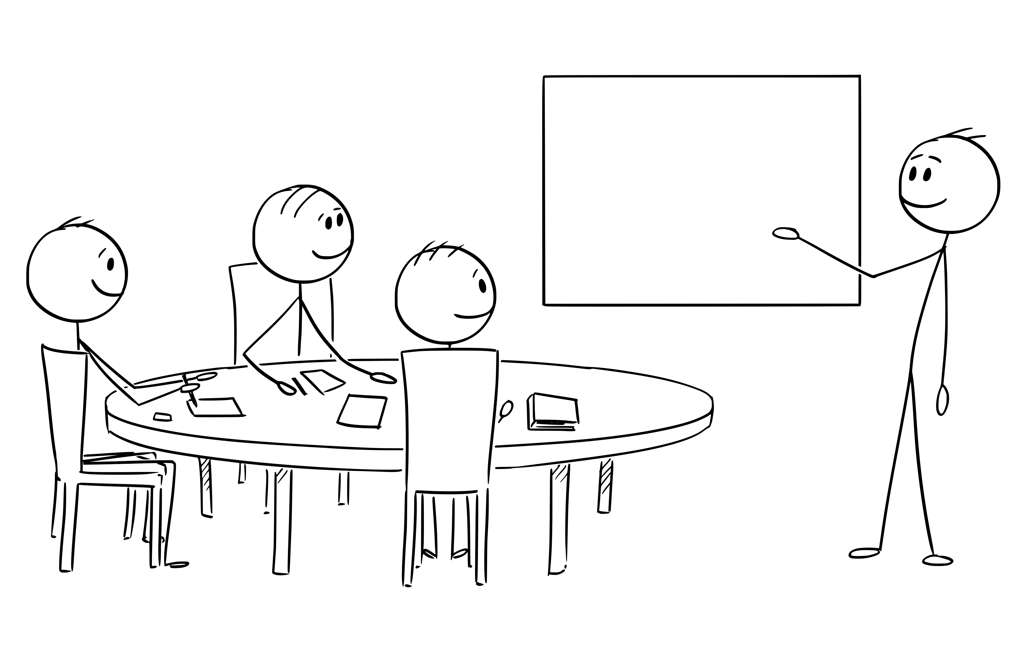
Notes:
Happiness was leading my team. Working with them, helping them grow, NOT all the other stuff.

Slide 43
Notes:
I missed this.

Slide 44
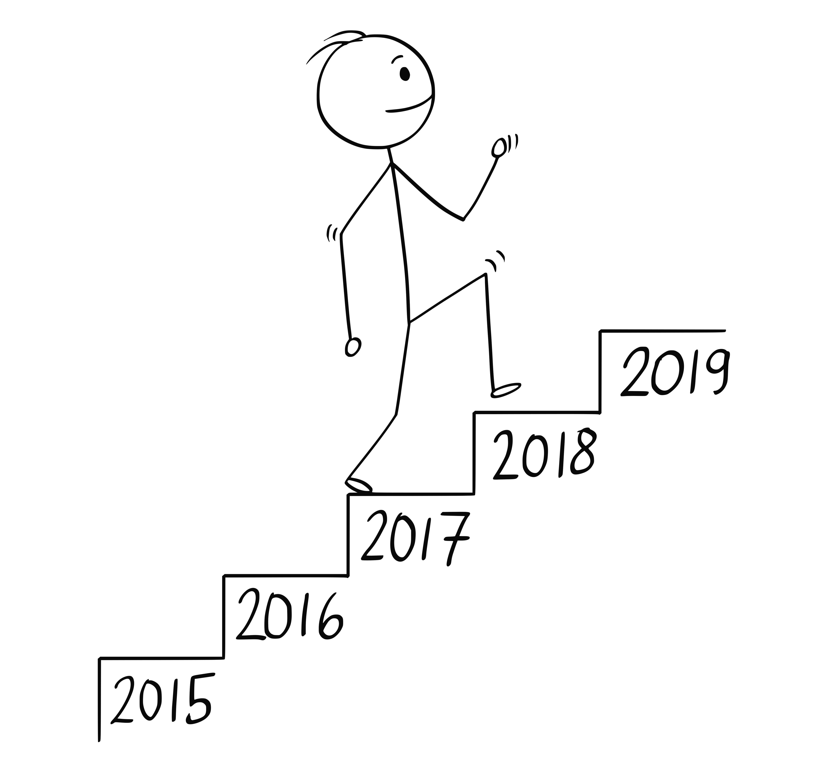

Slide 45
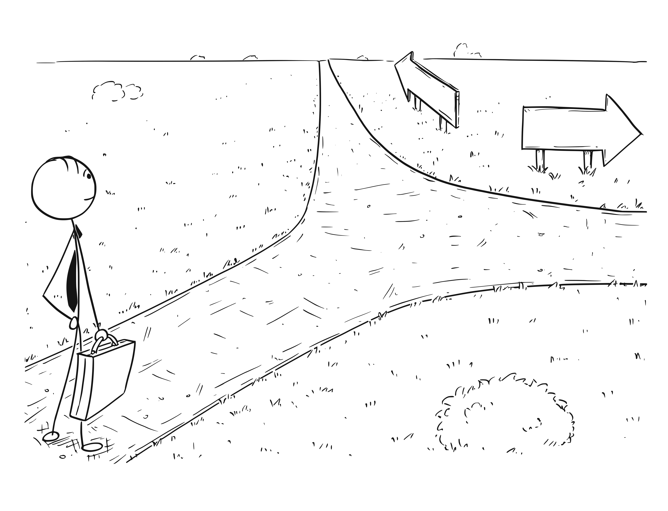

Slide 46
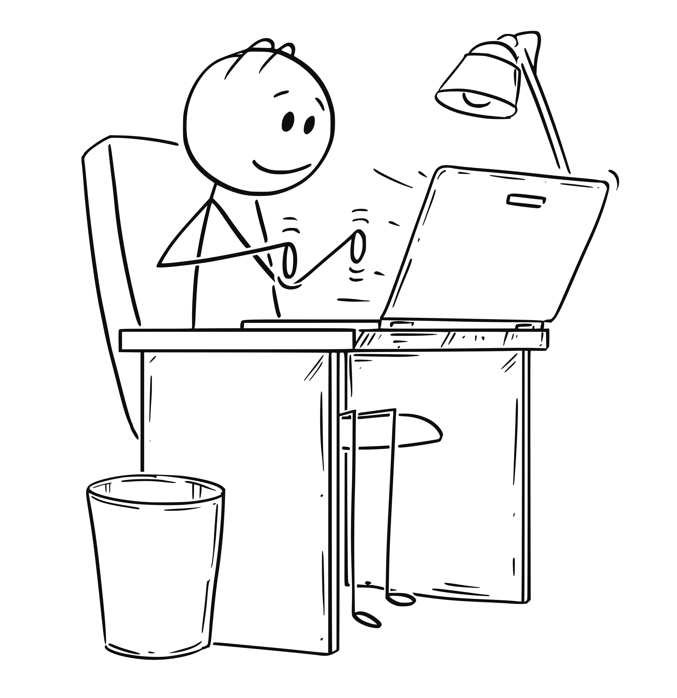

Slide 47
Developer
Leader
Notes:
I started to seriously consider it, but it still wasn’t a simple choice. I needed a Why.

Slide 48

Know your why
Work on your EQ
Lose your ego
Find a mentor
Leading friends can be tough. Be tough
Complain up or sideways, never down
Take the bad with the good
Seek feedback
Take the feedback for what it is…
Know when enough is enough
Be consistent
Own your mistakes

Slide 49
Leadership Journey, Jim Holmes
Extreme Ownership, Jocko Wilink / Leif Babin
Emotional Intelligence 2.0, Travis Bradberry / Jean Greaves
Leadership in the Shadows, Kyle Lamb
Will It Make the Boat Go Faster?, Ben Hunt-Davis
Red Circle, Brandon Webb
How to Win Friends and Influence People, Dale Carnegie
Ego is the Enemy, Ryan Holiday
Strengths Based Leadership, Tom Path

Slide 50
https://about.me/mjeaton

